Slide 1
How to make a (useful) theorem prover
Riyaz Ahuja

Slide 2
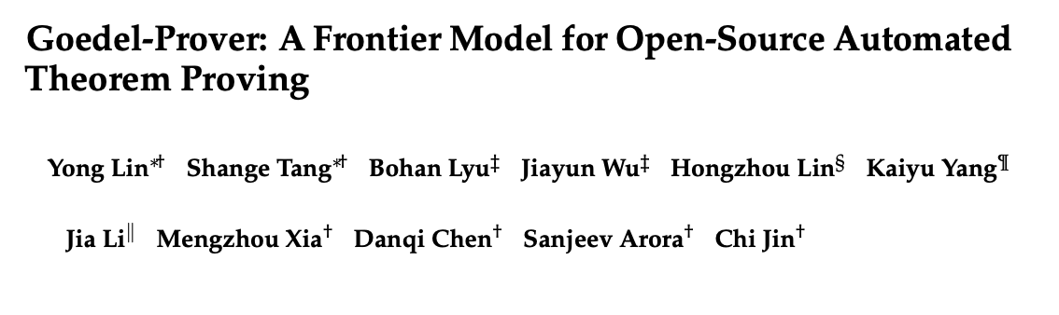
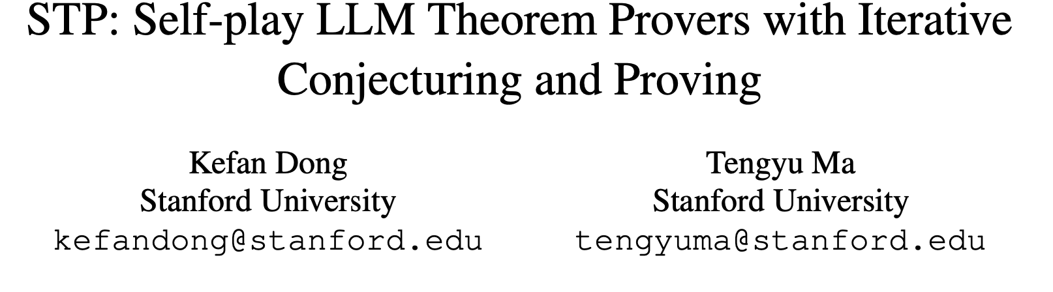
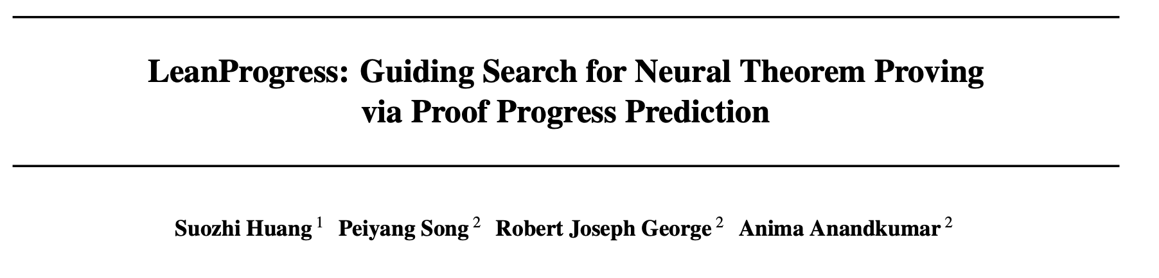
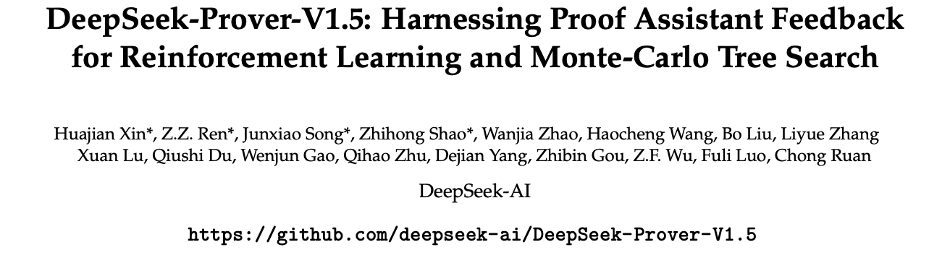
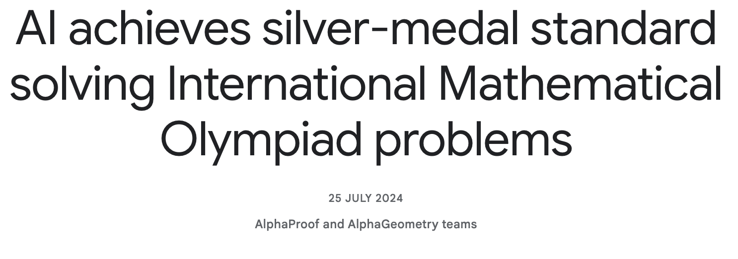
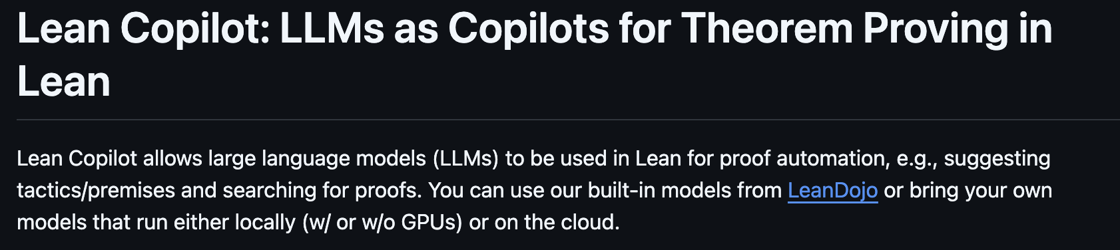
There are a lot of NTP’s being made:

Slide 3
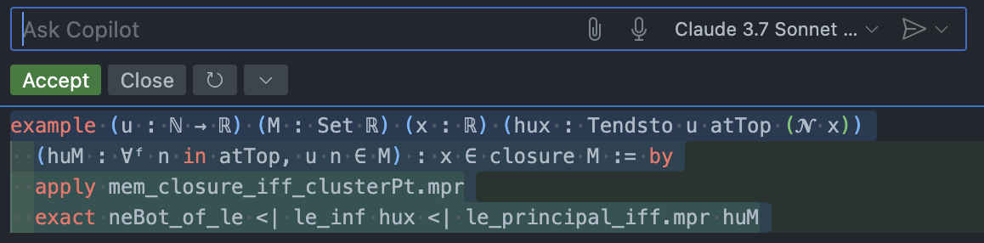
There are a lot of NTP’s being made:
However, most are not practical for actual users to use in their formalization work.
- Difficult to install
- Require GPU
- Not user-friendly
- Poor performance on real-world problems
- etc.
So, most formalizers use:
- symbolic methods (not an NTP, just a specialized hammer)
- Github Copilot + Claude
- (and a few use LeanCopilot, LLMLean, etc.)

Slide 4
How to make a (useful) theorem prover
Preliminaries
Interactive theorem proving in Lean
What is useful?
Issues with making an NTP
STP: Self-play LLM Theorem Provers
Architecture
Conjecturer-Prover System
Rewards and RL
Results
Goedel-Prover
Architecture
Autoformalization
Expert Iteration
Results
Other notable works
A Proposal

Slide 5
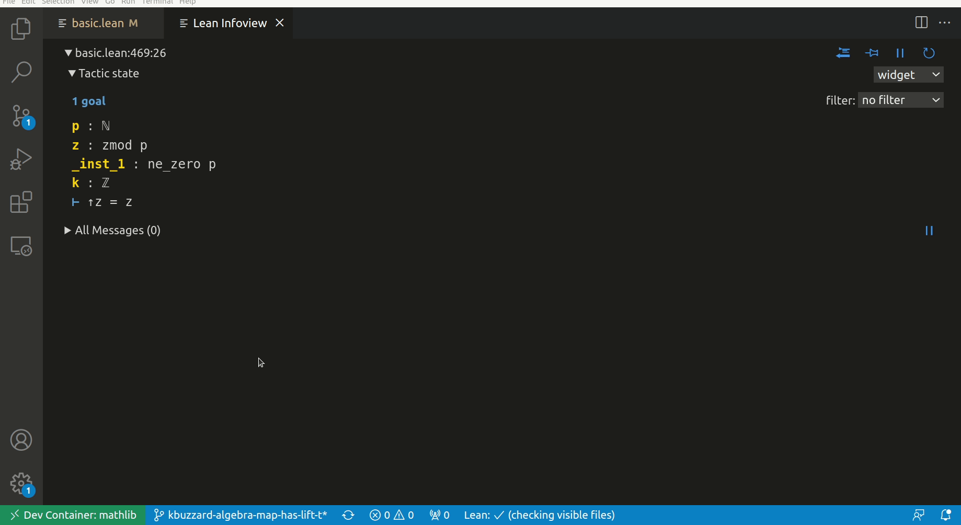
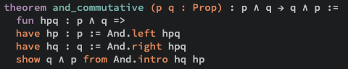
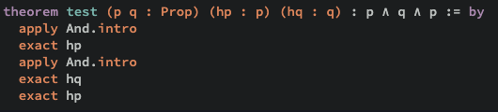
Preliminaries: Lean
“Lean is a functional programming language that makes it easy to write correct and maintainable code. You can also use Lean as an interactive theorem prover.”
Uses Dependent Type Theory (CoC w/ inductive types)
Term rewriting, simplification, and type inference is automatically handled by Lean
Rich metaprogramming suite and active mathematical library Mathlib

Slide 6
Preliminaries: What is Useful?
UX
Minimal setup and dependency requirements
Works well within existing formalization workflows and IDEs (e.g. tactic, command, or script)
Performance
Robust performance on practical, non-toy problems
Time efficient
Resource efficient (memory, GPU, etc.)
Readable and well-structured proofs
Extensibility & Interactivity
Customizable to specific user needs
Handles complex external proof dependencies
Custom tactics
Configurable to user needs
Notes:
Ease of Integration & Installation:
Talk about how many current NTPs are hard to install and configure. Explain that a useful prover should “just work” with minimal fuss.
Emphasize integration with tools like Lean, Mathlib, and existing proof environments, so users don’t have to switch ecosystems.
User-Friendliness:
Discuss why user-friendly design is critical. It’s not just for researchers but also for mathematicians who may not be machine learning experts.
Mention the importance of interactive feedback, clear error messages, and an interface that fits naturally into the formalization workflow.
Performance on Real-World Problems:
Highlight that while many research prototypes excel on benchmarks, they often struggle with complex, real-world formalization tasks.
Note that a useful prover should demonstrate strong performance on genuine problems and be resource efficient—ideally running on standard hardware or with moderate GPU requirements.
Reliability & Formal Verification:
Stress the need for the system to produce proofs that are rigorously verified by the underlying formal system, ensuring mathematical correctness.
Explain that reliable error diagnostics are essential so users can trust the prover and easily pinpoint issues.
Extensibility & Interactivity:
Talk about the benefits of designing a system that isn’t static—one that can incorporate additional features like autoformalization, expert iteration, or RL-based improvements as the field evolves.
Emphasize that interactivity (e.g., the ability to receive and act on feedback) is key for both research experimentation and practical usage.

Slide 7
Preliminaries: Challenges
Formal Data Scarcity
Limited high-quality, annotated formal proof data
Premise Selection & Proof Generation
Tactic-based vs. full-proof generation
Former more robust but localized and slower, and latter faster and better at planning but non-robust
For tactic-based, the question of search policy: MCTS, HTPS, etc.
Premise selection requires comprehensive analysis of enormous action space
Integration of Symbolic Methods
Have the model able to use a large set of tactics, including user-defined ones.
Generalization
Generalizing across different domains and proof styles
Compute
Do all of the above with a high level of performance, with as small a model locally hosted as possible
Alternatively, make a online api that users can access the model from.
Notes:
Speaker Notes
Premise Selection & Proof Generation:
Discuss how many neural theorem provers (NTPs) need to decide which tactics or lemmas to use at each step—this is very similar to the challenge of premise selection in symbolic systems.
Highlight that tactic-based generation involves searching through a vast space, where methods like MCTS help guide the search but must balance exploration (trying new tactics) with exploitation (following known successful tactics).
Formal Data Scarcity:
Emphasize that one of the biggest hurdles is the scarcity of high-quality formal proof data, which limits supervised training.
Mention that techniques like expert iteration and self-play are used to generate more formalized proofs, but they still can’t fully replace the depth of human-curated datasets.
Integration of Symbolic Methods & Library Learning:
Explain that while neural methods show promise in generating proof steps, integrating them with well-established symbolic tactics (advanced, domain-specific methods) remains challenging.
Point out that a useful prover must effectively tap into formal libraries (like Mathlib) and reconcile neural predictions with symbolic reasoning frameworks.
Scalability & Complexity:
Discuss the inherent complexity due to the combinatorial explosion in the number of possible proof steps and paths.
Note that a practical NTP must manage computational resources efficiently to be viable for real-world formalization tasks.
Generalization & Debugging:
Highlight that generalizing across diverse mathematical domains and proof styles is difficult with current models.
Stress the importance of providing interpretable feedback so users can understand where and why the prover might be failing—this is critical for iterative improvement.

Slide 8
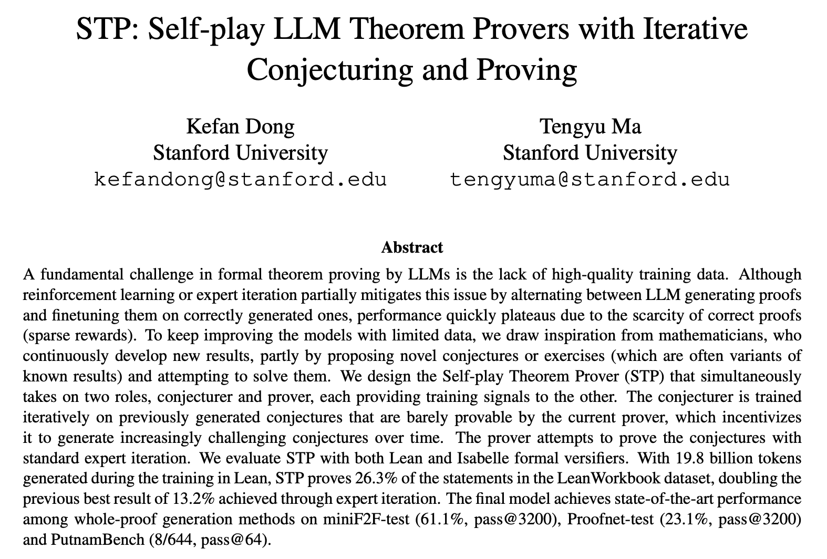
Notes:
Speaker Notes
Premise Selection & Proof Generation:
Discuss how many neural theorem provers (NTPs) need to decide which tactics or lemmas to use at each step—this is very similar to the challenge of premise selection in symbolic systems.
Highlight that tactic-based generation involves searching through a vast space, where methods like MCTS help guide the search but must balance exploration (trying new tactics) with exploitation (following known successful tactics).
Formal Data Scarcity:
Emphasize that one of the biggest hurdles is the scarcity of high-quality formal proof data, which limits supervised training.
Mention that techniques like expert iteration and self-play are used to generate more formalized proofs, but they still can’t fully replace the depth of human-curated datasets.
Integration of Symbolic Methods & Library Learning:
Explain that while neural methods show promise in generating proof steps, integrating them with well-established symbolic tactics (advanced, domain-specific methods) remains challenging.
Point out that a useful prover must effectively tap into formal libraries (like Mathlib) and reconcile neural predictions with symbolic reasoning frameworks.
Scalability & Complexity:
Discuss the inherent complexity due to the combinatorial explosion in the number of possible proof steps and paths.
Note that a practical NTP must manage computational resources efficiently to be viable for real-world formalization tasks.
Generalization & Debugging:
Highlight that generalizing across diverse mathematical domains and proof styles is difficult with current models.
Stress the importance of providing interpretable feedback so users can understand where and why the prover might be failing—this is critical for iterative improvement.

Slide 9
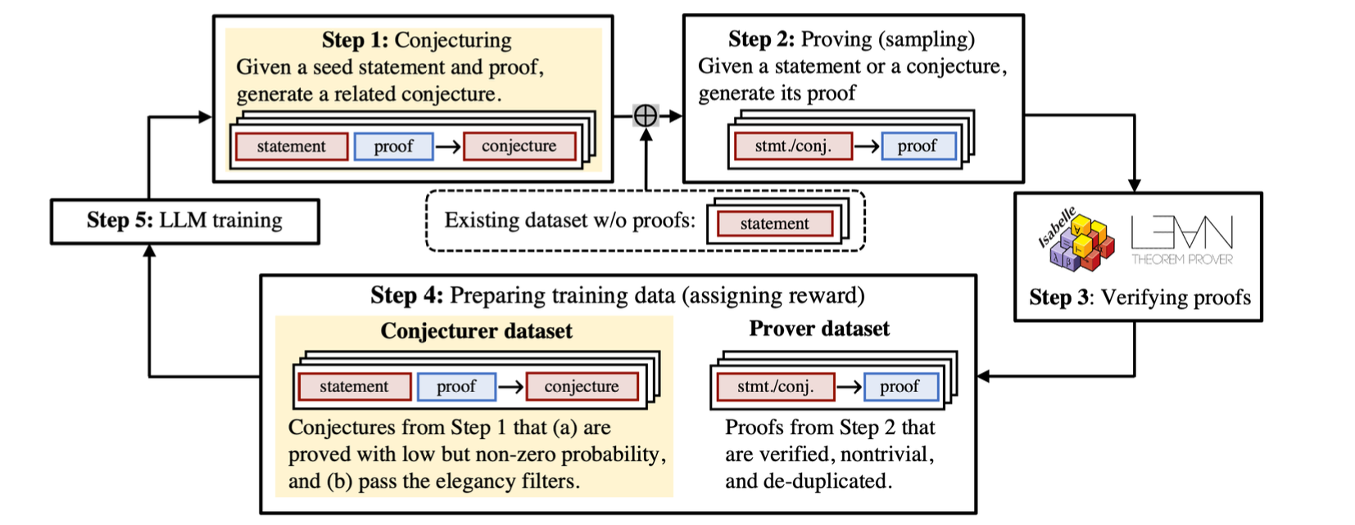
STP: Architecture
Tackles the data scarcity challenge using a self-play algorithm between conjectures and provers (automated curriculum learning with a self-generated adaptive curriculum (via conjecturers).)
Extension of Poesia et al. (2024)’s work on Minimo, which uses LLMS on the full infinite action space of Lean rather than the constrained action space of Peano.
This self-play loop is wrapped by STP phases.
Notes:
Speaker Notes
Premise Selection & Proof Generation:
Discuss how many neural theorem provers (NTPs) need to decide which tactics or lemmas to use at each step—this is very similar to the challenge of premise selection in symbolic systems.
Highlight that tactic-based generation involves searching through a vast space, where methods like MCTS help guide the search but must balance exploration (trying new tactics) with exploitation (following known successful tactics).
Formal Data Scarcity:
Emphasize that one of the biggest hurdles is the scarcity of high-quality formal proof data, which limits supervised training.
Mention that techniques like expert iteration and self-play are used to generate more formalized proofs, but they still can’t fully replace the depth of human-curated datasets.
Integration of Symbolic Methods & Library Learning:
Explain that while neural methods show promise in generating proof steps, integrating them with well-established symbolic tactics (advanced, domain-specific methods) remains challenging.
Point out that a useful prover must effectively tap into formal libraries (like Mathlib) and reconcile neural predictions with symbolic reasoning frameworks.
Scalability & Complexity:
Discuss the inherent complexity due to the combinatorial explosion in the number of possible proof steps and paths.
Note that a practical NTP must manage computational resources efficiently to be viable for real-world formalization tasks.
Generalization & Debugging:
Highlight that generalizing across diverse mathematical domains and proof styles is difficult with current models.
Stress the importance of providing interpretable feedback so users can understand where and why the prover might be failing—this is critical for iterative improvement.

Slide 10
STP: Architecture (Model Initialization)
Source Dataset
LeanWorkbook (~89K statements) is the dataset without proofs (for Isabelle, translate it using DeepSeek V2.5).
The SFT dataset for the Isabelle experiments is extracted from AFP3 and HOL.
The dataset for Lean is built by sampling 32 proofs per statement in LeanWorkbook (base DeepSeek-Prover-V1.5-SFT is already trained on it) and combine the correct proofs with examples from Mathlib.
Prover
Given the dataset of theorem statements and proofs, construct a SFT dataset where each example is the concatenation of a system prompt, a statement, and its corresponding proof.
Only compute the next token prediction loss on the proof (which is the expected output of the model).
To build this dataset, we simply extract all the statement-proof pairs in the proof library files and add a system prompt
Conjecturer
Given same source data, construct a dataset where each example is a concatenation of the system prompt, a lemma, and a seed statement and its proof.
Training loss is next token prediction loss.
A lemma used in the proof of the seed statement is also (optionally) provided so that generated conjectures are more likely to be related to the seed.
Notes:
Speaker Notes
Premise Selection & Proof Generation:
Discuss how many neural theorem provers (NTPs) need to decide which tactics or lemmas to use at each step—this is very similar to the challenge of premise selection in symbolic systems.
Highlight that tactic-based generation involves searching through a vast space, where methods like MCTS help guide the search but must balance exploration (trying new tactics) with exploitation (following known successful tactics).
Formal Data Scarcity:
Emphasize that one of the biggest hurdles is the scarcity of high-quality formal proof data, which limits supervised training.
Mention that techniques like expert iteration and self-play are used to generate more formalized proofs, but they still can’t fully replace the depth of human-curated datasets.
Integration of Symbolic Methods & Library Learning:
Explain that while neural methods show promise in generating proof steps, integrating them with well-established symbolic tactics (advanced, domain-specific methods) remains challenging.
Point out that a useful prover must effectively tap into formal libraries (like Mathlib) and reconcile neural predictions with symbolic reasoning frameworks.
Scalability & Complexity:
Discuss the inherent complexity due to the combinatorial explosion in the number of possible proof steps and paths.
Note that a practical NTP must manage computational resources efficiently to be viable for real-world formalization tasks.
Generalization & Debugging:
Highlight that generalizing across diverse mathematical domains and proof styles is difficult with current models.
Stress the importance of providing interpretable feedback so users can understand where and why the prover might be failing—this is critical for iterative improvement.

Slide 11
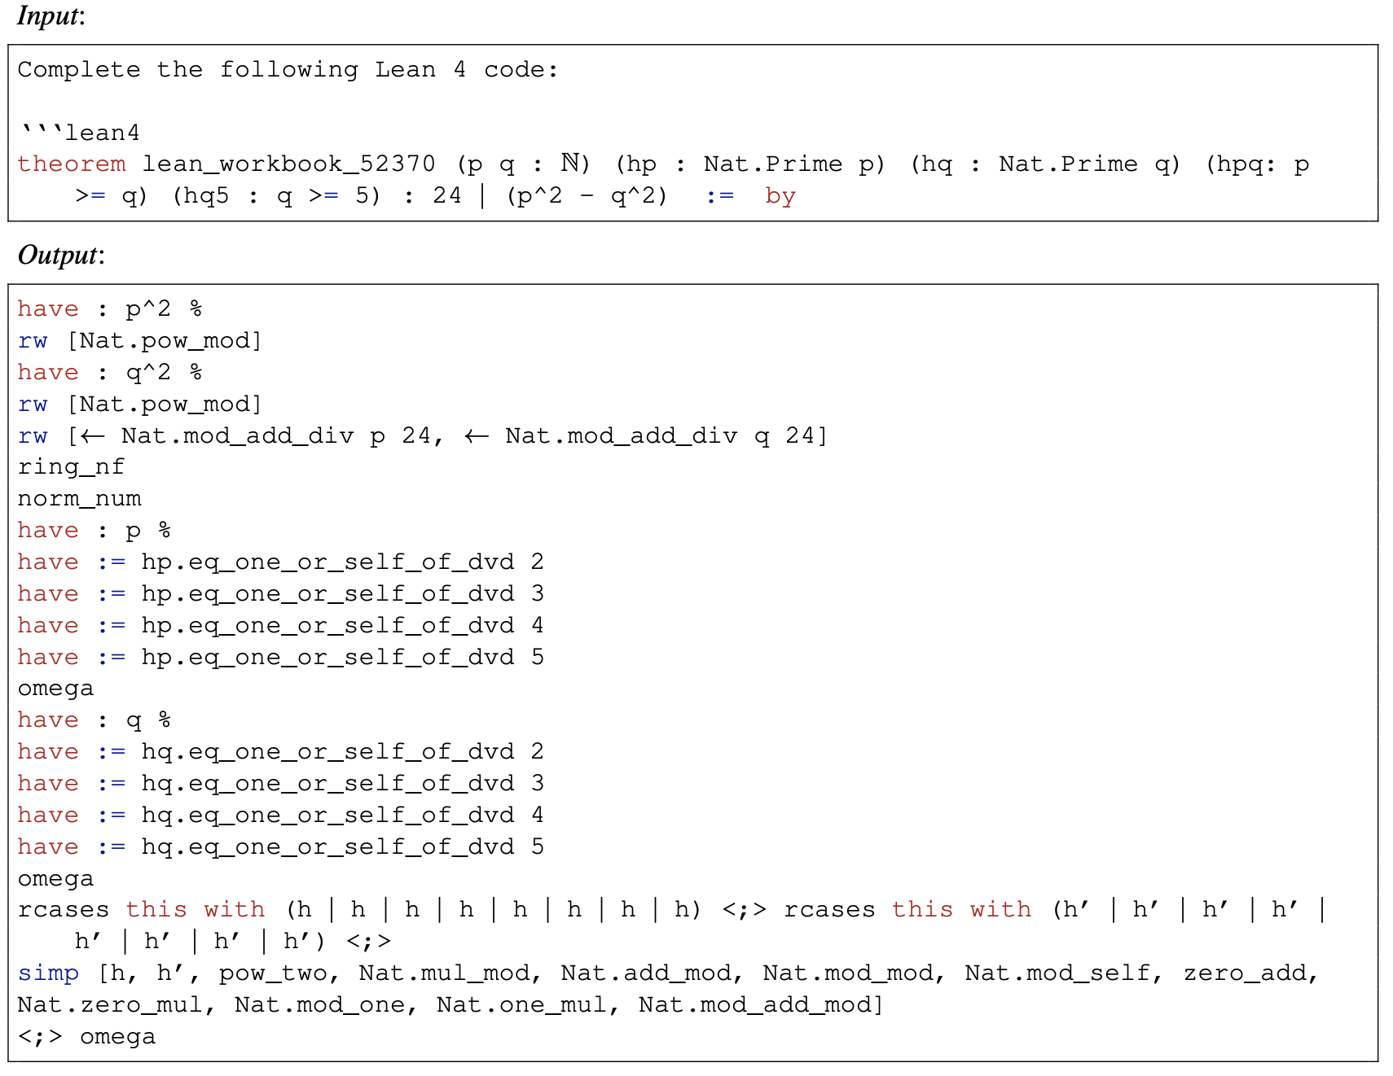
STP: Architecture (Model Initialization)
Prover
Notes:
Speaker Notes
Premise Selection & Proof Generation:
Discuss how many neural theorem provers (NTPs) need to decide which tactics or lemmas to use at each step—this is very similar to the challenge of premise selection in symbolic systems.
Highlight that tactic-based generation involves searching through a vast space, where methods like MCTS help guide the search but must balance exploration (trying new tactics) with exploitation (following known successful tactics).
Formal Data Scarcity:
Emphasize that one of the biggest hurdles is the scarcity of high-quality formal proof data, which limits supervised training.
Mention that techniques like expert iteration and self-play are used to generate more formalized proofs, but they still can’t fully replace the depth of human-curated datasets.
Integration of Symbolic Methods & Library Learning:
Explain that while neural methods show promise in generating proof steps, integrating them with well-established symbolic tactics (advanced, domain-specific methods) remains challenging.
Point out that a useful prover must effectively tap into formal libraries (like Mathlib) and reconcile neural predictions with symbolic reasoning frameworks.
Scalability & Complexity:
Discuss the inherent complexity due to the combinatorial explosion in the number of possible proof steps and paths.
Note that a practical NTP must manage computational resources efficiently to be viable for real-world formalization tasks.
Generalization & Debugging:
Highlight that generalizing across diverse mathematical domains and proof styles is difficult with current models.
Stress the importance of providing interpretable feedback so users can understand where and why the prover might be failing—this is critical for iterative improvement.

Slide 12
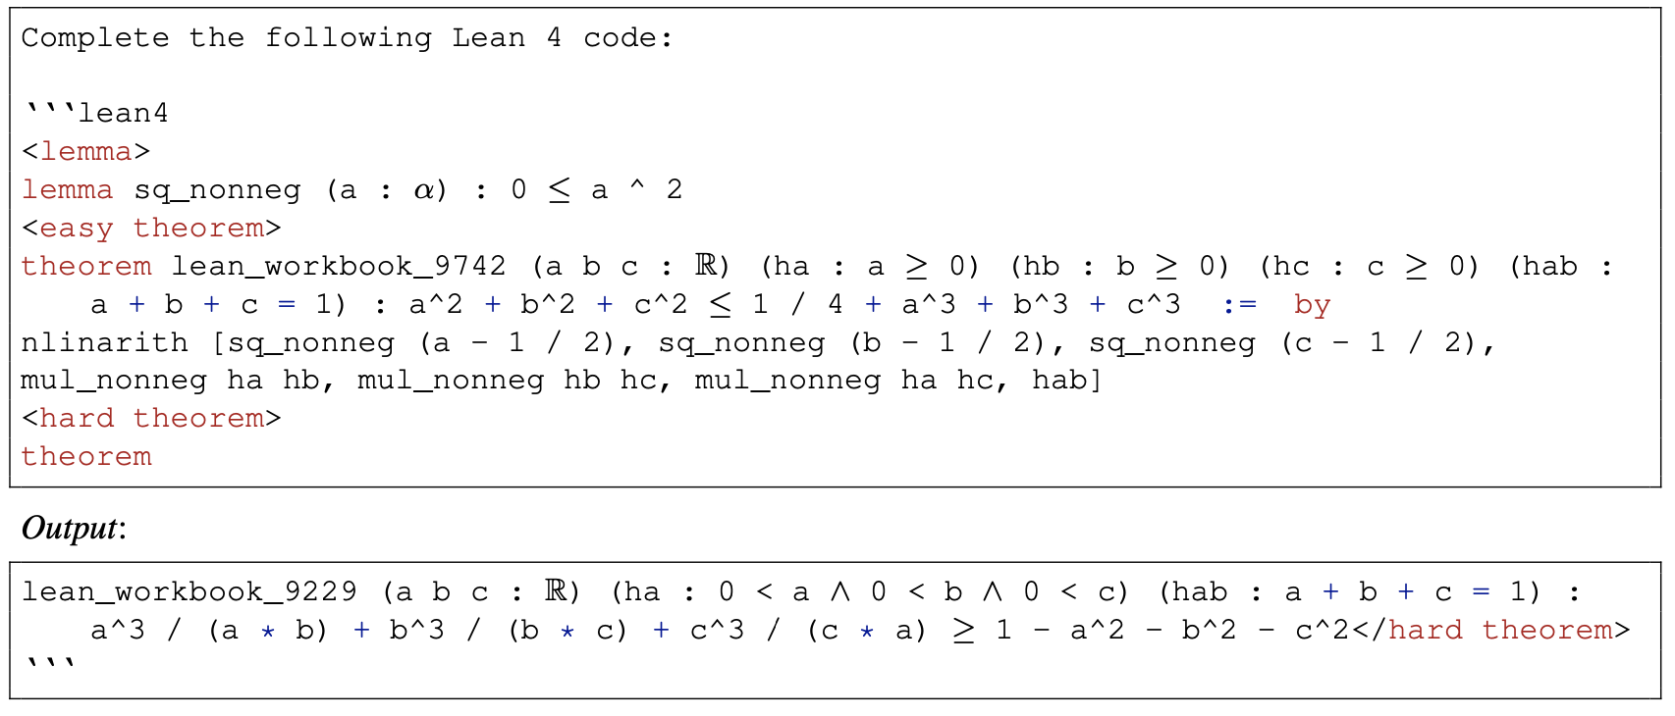
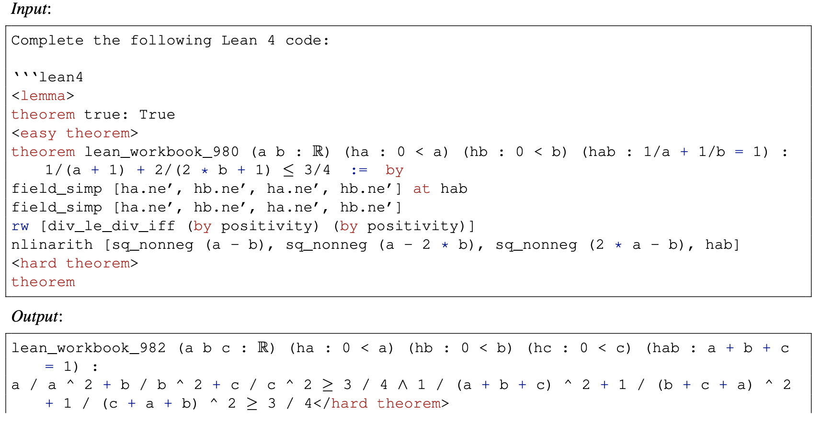
STP: Architecture (Model Initialization)
Conjecturer
Notes:
Speaker Notes
Premise Selection & Proof Generation:
Discuss how many neural theorem provers (NTPs) need to decide which tactics or lemmas to use at each step—this is very similar to the challenge of premise selection in symbolic systems.
Highlight that tactic-based generation involves searching through a vast space, where methods like MCTS help guide the search but must balance exploration (trying new tactics) with exploitation (following known successful tactics).
Formal Data Scarcity:
Emphasize that one of the biggest hurdles is the scarcity of high-quality formal proof data, which limits supervised training.
Mention that techniques like expert iteration and self-play are used to generate more formalized proofs, but they still can’t fully replace the depth of human-curated datasets.
Integration of Symbolic Methods & Library Learning:
Explain that while neural methods show promise in generating proof steps, integrating them with well-established symbolic tactics (advanced, domain-specific methods) remains challenging.
Point out that a useful prover must effectively tap into formal libraries (like Mathlib) and reconcile neural predictions with symbolic reasoning frameworks.
Scalability & Complexity:
Discuss the inherent complexity due to the combinatorial explosion in the number of possible proof steps and paths.
Note that a practical NTP must manage computational resources efficiently to be viable for real-world formalization tasks.
Generalization & Debugging:
Highlight that generalizing across diverse mathematical domains and proof styles is difficult with current models.
Stress the importance of providing interpretable feedback so users can understand where and why the prover might be failing—this is critical for iterative improvement.

Slide 13
STP: Architecture (Self-Play Loop)
Notes:
Speaker Notes
Premise Selection & Proof Generation:
Discuss how many neural theorem provers (NTPs) need to decide which tactics or lemmas to use at each step—this is very similar to the challenge of premise selection in symbolic systems.
Highlight that tactic-based generation involves searching through a vast space, where methods like MCTS help guide the search but must balance exploration (trying new tactics) with exploitation (following known successful tactics).
Formal Data Scarcity:
Emphasize that one of the biggest hurdles is the scarcity of high-quality formal proof data, which limits supervised training.
Mention that techniques like expert iteration and self-play are used to generate more formalized proofs, but they still can’t fully replace the depth of human-curated datasets.
Integration of Symbolic Methods & Library Learning:
Explain that while neural methods show promise in generating proof steps, integrating them with well-established symbolic tactics (advanced, domain-specific methods) remains challenging.
Point out that a useful prover must effectively tap into formal libraries (like Mathlib) and reconcile neural predictions with symbolic reasoning frameworks.
Scalability & Complexity:
Discuss the inherent complexity due to the combinatorial explosion in the number of possible proof steps and paths.
Note that a practical NTP must manage computational resources efficiently to be viable for real-world formalization tasks.
Generalization & Debugging:
Highlight that generalizing across diverse mathematical domains and proof styles is difficult with current models.
Stress the importance of providing interpretable feedback so users can understand where and why the prover might be failing—this is critical for iterative improvement.

Slide 14
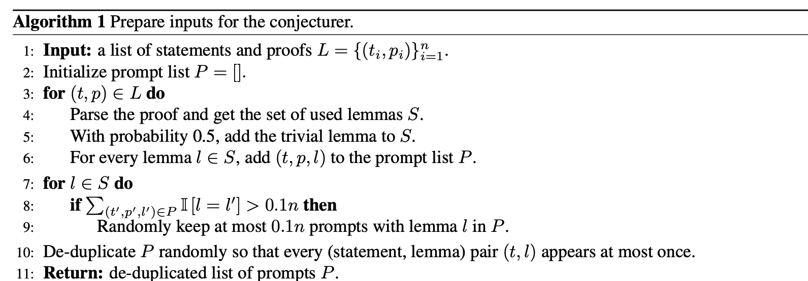
STP: Architecture (Self-Play Loop)
Conjecturing:
Collect a list of the conjecturer’s inputs in the same format as in the conjecture SFT dataset from lemma-theorem-proof tuples (theorems from the given dataset without proofs, proofs are previously generated, and seed lemmas are extracted.
Then, the LLM generates conjectures from the inputs, and we randomly select a subset of the generated conjectures with size no larger than the number of remaining unproved statements in the given dataset, so that the prover’s compute budget is split equally between the conjectures and statements.
Notes:
Speaker Notes
Premise Selection & Proof Generation:
Discuss how many neural theorem provers (NTPs) need to decide which tactics or lemmas to use at each step—this is very similar to the challenge of premise selection in symbolic systems.
Highlight that tactic-based generation involves searching through a vast space, where methods like MCTS help guide the search but must balance exploration (trying new tactics) with exploitation (following known successful tactics).
Formal Data Scarcity:
Emphasize that one of the biggest hurdles is the scarcity of high-quality formal proof data, which limits supervised training.
Mention that techniques like expert iteration and self-play are used to generate more formalized proofs, but they still can’t fully replace the depth of human-curated datasets.
Integration of Symbolic Methods & Library Learning:
Explain that while neural methods show promise in generating proof steps, integrating them with well-established symbolic tactics (advanced, domain-specific methods) remains challenging.
Point out that a useful prover must effectively tap into formal libraries (like Mathlib) and reconcile neural predictions with symbolic reasoning frameworks.
Scalability & Complexity:
Discuss the inherent complexity due to the combinatorial explosion in the number of possible proof steps and paths.
Note that a practical NTP must manage computational resources efficiently to be viable for real-world formalization tasks.
Generalization & Debugging:
Highlight that generalizing across diverse mathematical domains and proof styles is difficult with current models.
Stress the importance of providing interpretable feedback so users can understand where and why the prover might be failing—this is critical for iterative improvement.

Slide 15
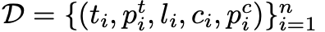
STP: Architecture (Self-Play Loop)
2. Proving (Sampling):
For the prover’s inputs, combine the generated conjectures and the unproved statements in the existing dataset.
Then, independently sample K=64 proofs per statement/conjecture.
3. Verifying:
Send to Lean (or Isabelle) for elaboration and correctness verification
4. Assign Rewards:
Organize into examples of , for seed statement, proof, lemma, conjectured statement, and proof of conjecture.
(For prover) Filter D over correct generated proofs where the empirical pass rate of the corresponding
statement/conjecture is below 1/2. (other correct proofs over ½ are considered “trivial”).
The prover is then trained on a replay buffer containing the selected proofs from the last three iterations.
Notes:
Speaker Notes
Premise Selection & Proof Generation:
Discuss how many neural theorem provers (NTPs) need to decide which tactics or lemmas to use at each step—this is very similar to the challenge of premise selection in symbolic systems.
Highlight that tactic-based generation involves searching through a vast space, where methods like MCTS help guide the search but must balance exploration (trying new tactics) with exploitation (following known successful tactics).
Formal Data Scarcity:
Emphasize that one of the biggest hurdles is the scarcity of high-quality formal proof data, which limits supervised training.
Mention that techniques like expert iteration and self-play are used to generate more formalized proofs, but they still can’t fully replace the depth of human-curated datasets.
Integration of Symbolic Methods & Library Learning:
Explain that while neural methods show promise in generating proof steps, integrating them with well-established symbolic tactics (advanced, domain-specific methods) remains challenging.
Point out that a useful prover must effectively tap into formal libraries (like Mathlib) and reconcile neural predictions with symbolic reasoning frameworks.
Scalability & Complexity:
Discuss the inherent complexity due to the combinatorial explosion in the number of possible proof steps and paths.
Note that a practical NTP must manage computational resources efficiently to be viable for real-world formalization tasks.
Generalization & Debugging:
Highlight that generalizing across diverse mathematical domains and proof styles is difficult with current models.
Stress the importance of providing interpretable feedback so users can understand where and why the prover might be failing—this is critical for iterative improvement.

Slide 16
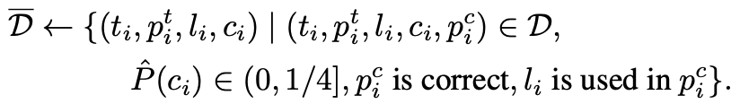
STP: Architecture (Self-Play Loop)
4. Assign Rewards:
Organize into examples of , for seed statement, proof, lemma, conjectured statement, and proof of conjecture.
Determine the “difficulty” of each conjecture via empirical pass rate:
c. Filter the dataset:
d. Filter by “elegance”: remove conjectures whose minimum proof length divided by the length of the conjecture is in the lowest 20% of remaining examples.
e. Reweight the selected conjectures
Conjecture reward cannot solely dependent on the generated conjectures may degenerate to a singular distribution. In reality, the given dataset typically has multiple modes because the statements focus on different topics.
Compute a distribution P supported on the selected conjectures that minimizes the Wasserstein distance to the uniform distribution over unproved theorems, denoted by Q. The similarity between a conjecture and a statement, used for computing the Wasserstein distance between P and Q, is defined as the negative cosine similarity between their embeddings (given by the current model).
Notes:
Speaker Notes
Premise Selection & Proof Generation:
Discuss how many neural theorem provers (NTPs) need to decide which tactics or lemmas to use at each step—this is very similar to the challenge of premise selection in symbolic systems.
Highlight that tactic-based generation involves searching through a vast space, where methods like MCTS help guide the search but must balance exploration (trying new tactics) with exploitation (following known successful tactics).
Formal Data Scarcity:
Emphasize that one of the biggest hurdles is the scarcity of high-quality formal proof data, which limits supervised training.
Mention that techniques like expert iteration and self-play are used to generate more formalized proofs, but they still can’t fully replace the depth of human-curated datasets.
Integration of Symbolic Methods & Library Learning:
Explain that while neural methods show promise in generating proof steps, integrating them with well-established symbolic tactics (advanced, domain-specific methods) remains challenging.
Point out that a useful prover must effectively tap into formal libraries (like Mathlib) and reconcile neural predictions with symbolic reasoning frameworks.
Scalability & Complexity:
Discuss the inherent complexity due to the combinatorial explosion in the number of possible proof steps and paths.
Note that a practical NTP must manage computational resources efficiently to be viable for real-world formalization tasks.
Generalization & Debugging:
Highlight that generalizing across diverse mathematical domains and proof styles is difficult with current models.
Stress the importance of providing interpretable feedback so users can understand where and why the prover might be failing—this is critical for iterative improvement.

Slide 17
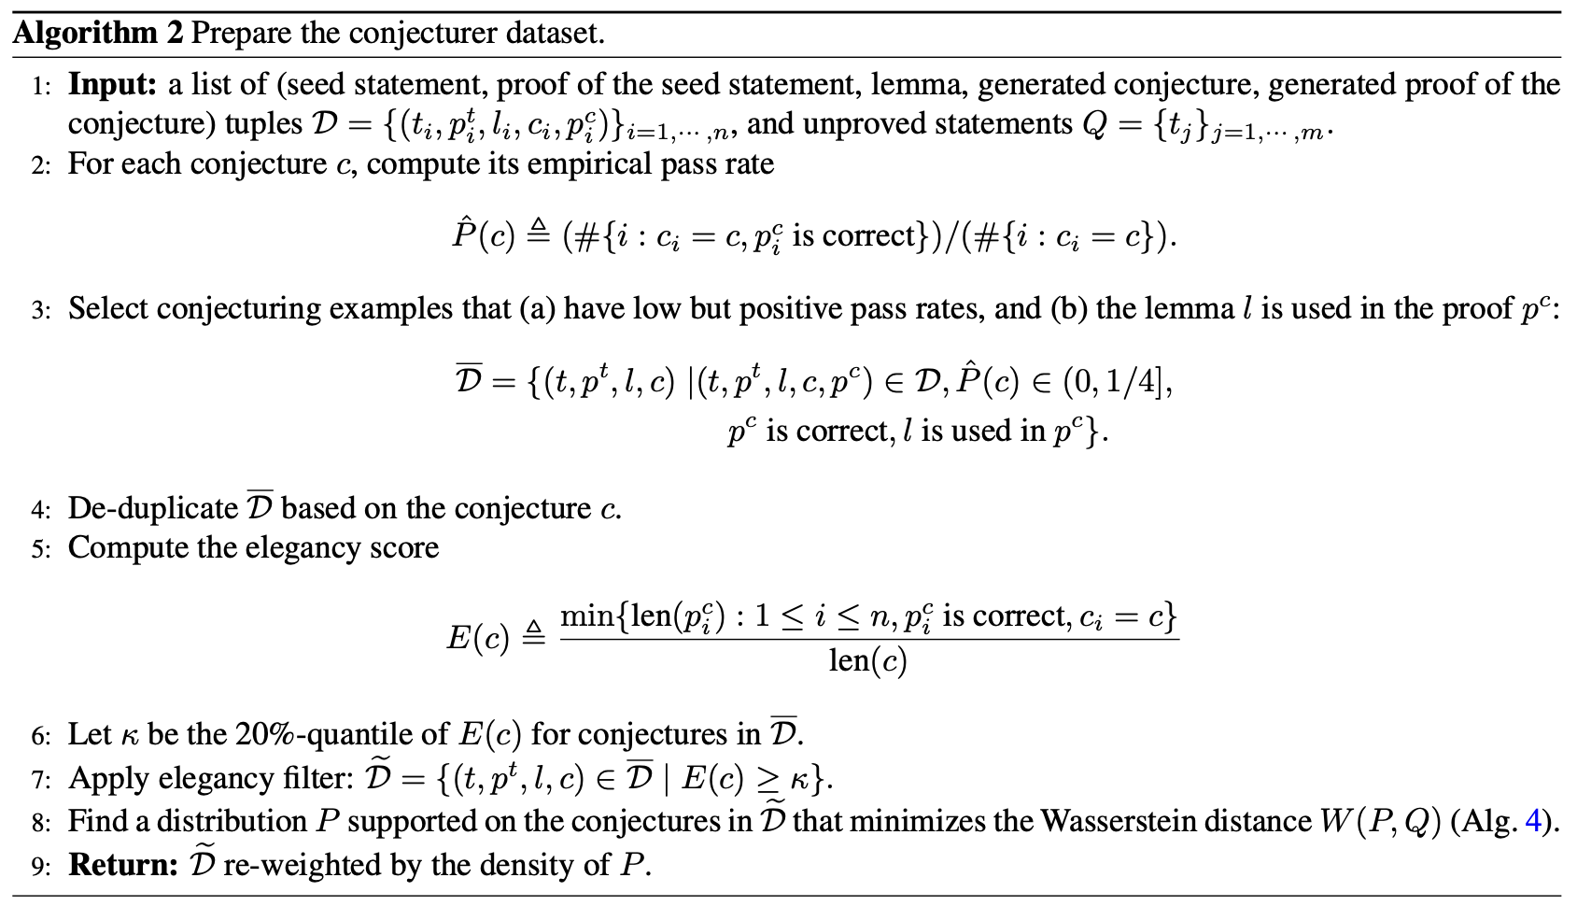
STP: Architecture (Self-Play Loop)
4. Assign Rewards:
Notes:
Speaker Notes
Premise Selection & Proof Generation:
Discuss how many neural theorem provers (NTPs) need to decide which tactics or lemmas to use at each step—this is very similar to the challenge of premise selection in symbolic systems.
Highlight that tactic-based generation involves searching through a vast space, where methods like MCTS help guide the search but must balance exploration (trying new tactics) with exploitation (following known successful tactics).
Formal Data Scarcity:
Emphasize that one of the biggest hurdles is the scarcity of high-quality formal proof data, which limits supervised training.
Mention that techniques like expert iteration and self-play are used to generate more formalized proofs, but they still can’t fully replace the depth of human-curated datasets.
Integration of Symbolic Methods & Library Learning:
Explain that while neural methods show promise in generating proof steps, integrating them with well-established symbolic tactics (advanced, domain-specific methods) remains challenging.
Point out that a useful prover must effectively tap into formal libraries (like Mathlib) and reconcile neural predictions with symbolic reasoning frameworks.
Scalability & Complexity:
Discuss the inherent complexity due to the combinatorial explosion in the number of possible proof steps and paths.
Note that a practical NTP must manage computational resources efficiently to be viable for real-world formalization tasks.
Generalization & Debugging:
Highlight that generalizing across diverse mathematical domains and proof styles is difficult with current models.
Stress the importance of providing interpretable feedback so users can understand where and why the prover might be failing—this is critical for iterative improvement.

Slide 18
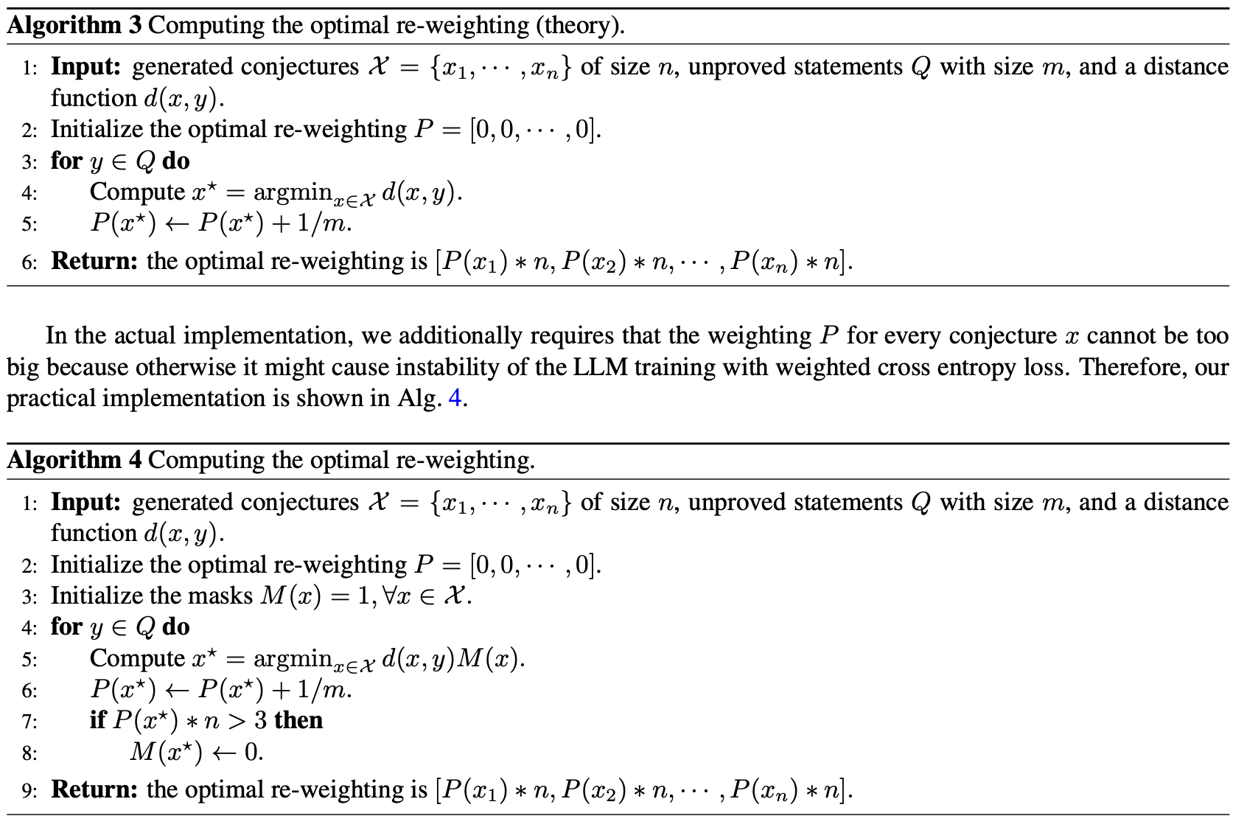
STP: Architecture (Self-Play Loop)
4. Assign Rewards:
e. Reweight the conjectures
Notes:
Speaker Notes
Premise Selection & Proof Generation:
Discuss how many neural theorem provers (NTPs) need to decide which tactics or lemmas to use at each step—this is very similar to the challenge of premise selection in symbolic systems.
Highlight that tactic-based generation involves searching through a vast space, where methods like MCTS help guide the search but must balance exploration (trying new tactics) with exploitation (following known successful tactics).
Formal Data Scarcity:
Emphasize that one of the biggest hurdles is the scarcity of high-quality formal proof data, which limits supervised training.
Mention that techniques like expert iteration and self-play are used to generate more formalized proofs, but they still can’t fully replace the depth of human-curated datasets.
Integration of Symbolic Methods & Library Learning:
Explain that while neural methods show promise in generating proof steps, integrating them with well-established symbolic tactics (advanced, domain-specific methods) remains challenging.
Point out that a useful prover must effectively tap into formal libraries (like Mathlib) and reconcile neural predictions with symbolic reasoning frameworks.
Scalability & Complexity:
Discuss the inherent complexity due to the combinatorial explosion in the number of possible proof steps and paths.
Note that a practical NTP must manage computational resources efficiently to be viable for real-world formalization tasks.
Generalization & Debugging:
Highlight that generalizing across diverse mathematical domains and proof styles is difficult with current models.
Stress the importance of providing interpretable feedback so users can understand where and why the prover might be failing—this is critical for iterative improvement.

Slide 19
STP: Architecture (Self-Play Loop)
5. LLM Training:
Use weighted cross entropy loss computed on the conjectures/proofs respectively. For the proof dataset, we weight the examples reciprocally to the number of verified proofs to the corresponding statement/conjecture.
Apply a length penalization of the form γL to reward simpler proofs, where γ = exp(-0.001) is the discount factor.
Notes:
Speaker Notes
Premise Selection & Proof Generation:
Discuss how many neural theorem provers (NTPs) need to decide which tactics or lemmas to use at each step—this is very similar to the challenge of premise selection in symbolic systems.
Highlight that tactic-based generation involves searching through a vast space, where methods like MCTS help guide the search but must balance exploration (trying new tactics) with exploitation (following known successful tactics).
Formal Data Scarcity:
Emphasize that one of the biggest hurdles is the scarcity of high-quality formal proof data, which limits supervised training.
Mention that techniques like expert iteration and self-play are used to generate more formalized proofs, but they still can’t fully replace the depth of human-curated datasets.
Integration of Symbolic Methods & Library Learning:
Explain that while neural methods show promise in generating proof steps, integrating them with well-established symbolic tactics (advanced, domain-specific methods) remains challenging.
Point out that a useful prover must effectively tap into formal libraries (like Mathlib) and reconcile neural predictions with symbolic reasoning frameworks.
Scalability & Complexity:
Discuss the inherent complexity due to the combinatorial explosion in the number of possible proof steps and paths.
Note that a practical NTP must manage computational resources efficiently to be viable for real-world formalization tasks.
Generalization & Debugging:
Highlight that generalizing across diverse mathematical domains and proof styles is difficult with current models.
Stress the importance of providing interpretable feedback so users can understand where and why the prover might be failing—this is critical for iterative improvement.

Slide 20
STP: Architecture (Final SFT)
As the data distribution constantly changes during self-play, this final model may have some training instability
Re-train the final model checkpoint from the base model (before first SFT) on a combination of the SFT dataset and all the correct and “difficult” proofs generated during self-play.
Difficult proofs means those whose corresponding statement/conjecture has an empirical pass rate at most 1/4.
For every statement/conjecture, randomly keep at most 16 distinct proofs to speedup the training
Notes:
Speaker Notes
Premise Selection & Proof Generation:
Discuss how many neural theorem provers (NTPs) need to decide which tactics or lemmas to use at each step—this is very similar to the challenge of premise selection in symbolic systems.
Highlight that tactic-based generation involves searching through a vast space, where methods like MCTS help guide the search but must balance exploration (trying new tactics) with exploitation (following known successful tactics).
Formal Data Scarcity:
Emphasize that one of the biggest hurdles is the scarcity of high-quality formal proof data, which limits supervised training.
Mention that techniques like expert iteration and self-play are used to generate more formalized proofs, but they still can’t fully replace the depth of human-curated datasets.
Integration of Symbolic Methods & Library Learning:
Explain that while neural methods show promise in generating proof steps, integrating them with well-established symbolic tactics (advanced, domain-specific methods) remains challenging.
Point out that a useful prover must effectively tap into formal libraries (like Mathlib) and reconcile neural predictions with symbolic reasoning frameworks.
Scalability & Complexity:
Discuss the inherent complexity due to the combinatorial explosion in the number of possible proof steps and paths.
Note that a practical NTP must manage computational resources efficiently to be viable for real-world formalization tasks.
Generalization & Debugging:
Highlight that generalizing across diverse mathematical domains and proof styles is difficult with current models.
Stress the importance of providing interpretable feedback so users can understand where and why the prover might be failing—this is critical for iterative improvement.

Slide 21
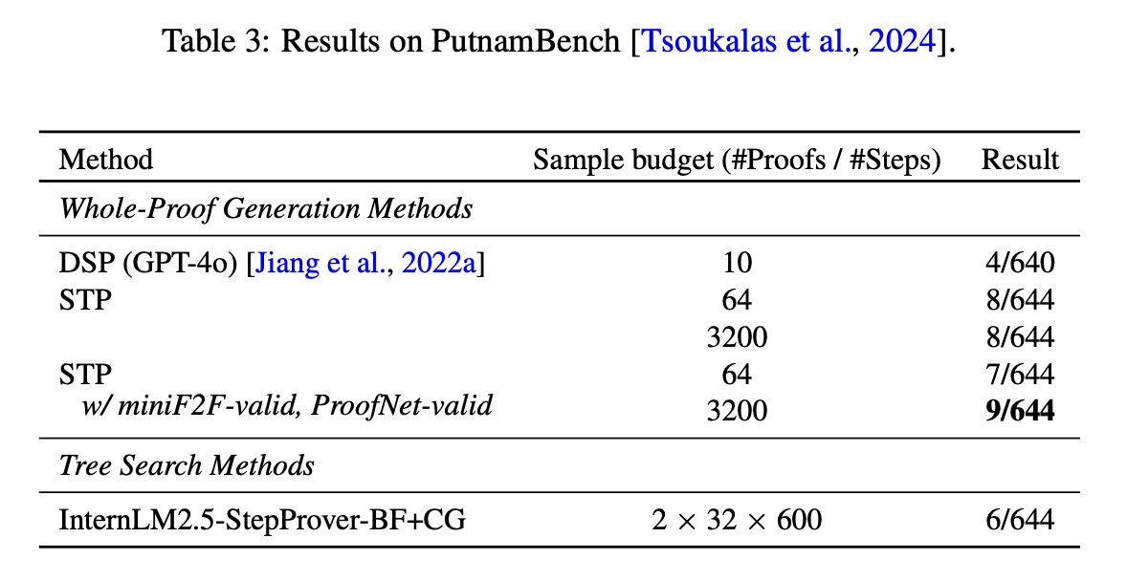
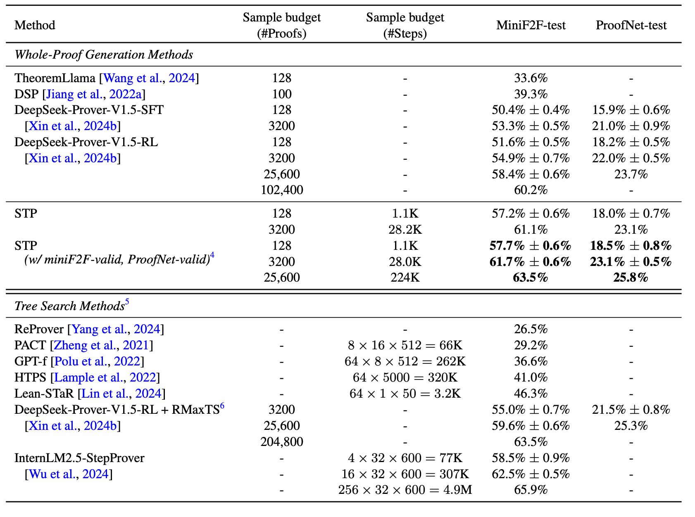
STP: Results
Notes:
Speaker Notes
Premise Selection & Proof Generation:
Discuss how many neural theorem provers (NTPs) need to decide which tactics or lemmas to use at each step—this is very similar to the challenge of premise selection in symbolic systems.
Highlight that tactic-based generation involves searching through a vast space, where methods like MCTS help guide the search but must balance exploration (trying new tactics) with exploitation (following known successful tactics).
Formal Data Scarcity:
Emphasize that one of the biggest hurdles is the scarcity of high-quality formal proof data, which limits supervised training.
Mention that techniques like expert iteration and self-play are used to generate more formalized proofs, but they still can’t fully replace the depth of human-curated datasets.
Integration of Symbolic Methods & Library Learning:
Explain that while neural methods show promise in generating proof steps, integrating them with well-established symbolic tactics (advanced, domain-specific methods) remains challenging.
Point out that a useful prover must effectively tap into formal libraries (like Mathlib) and reconcile neural predictions with symbolic reasoning frameworks.
Scalability & Complexity:
Discuss the inherent complexity due to the combinatorial explosion in the number of possible proof steps and paths.
Note that a practical NTP must manage computational resources efficiently to be viable for real-world formalization tasks.
Generalization & Debugging:
Highlight that generalizing across diverse mathematical domains and proof styles is difficult with current models.
Stress the importance of providing interpretable feedback so users can understand where and why the prover might be failing—this is critical for iterative improvement.

Slide 22
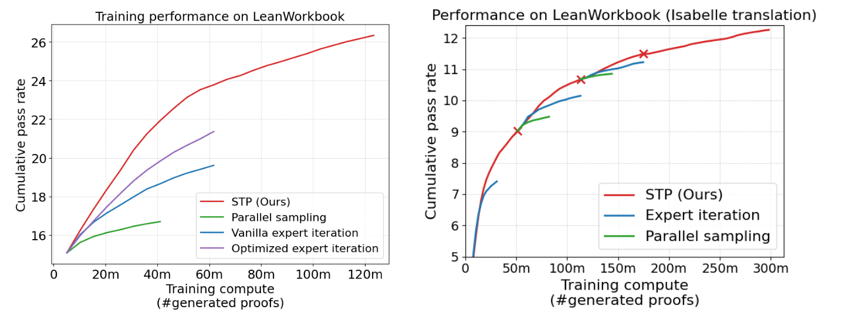
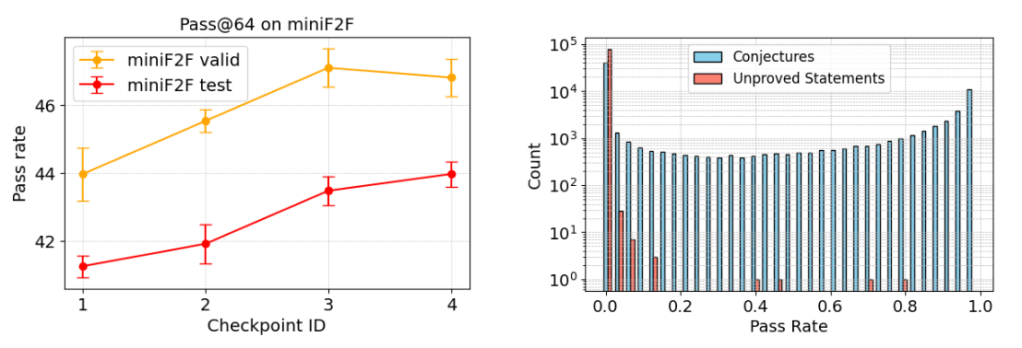
STP: Results
Notes:
Speaker Notes
Premise Selection & Proof Generation:
Discuss how many neural theorem provers (NTPs) need to decide which tactics or lemmas to use at each step—this is very similar to the challenge of premise selection in symbolic systems.
Highlight that tactic-based generation involves searching through a vast space, where methods like MCTS help guide the search but must balance exploration (trying new tactics) with exploitation (following known successful tactics).
Formal Data Scarcity:
Emphasize that one of the biggest hurdles is the scarcity of high-quality formal proof data, which limits supervised training.
Mention that techniques like expert iteration and self-play are used to generate more formalized proofs, but they still can’t fully replace the depth of human-curated datasets.
Integration of Symbolic Methods & Library Learning:
Explain that while neural methods show promise in generating proof steps, integrating them with well-established symbolic tactics (advanced, domain-specific methods) remains challenging.
Point out that a useful prover must effectively tap into formal libraries (like Mathlib) and reconcile neural predictions with symbolic reasoning frameworks.
Scalability & Complexity:
Discuss the inherent complexity due to the combinatorial explosion in the number of possible proof steps and paths.
Note that a practical NTP must manage computational resources efficiently to be viable for real-world formalization tasks.
Generalization & Debugging:
Highlight that generalizing across diverse mathematical domains and proof styles is difficult with current models.
Stress the importance of providing interpretable feedback so users can understand where and why the prover might be failing—this is critical for iterative improvement.

Slide 23
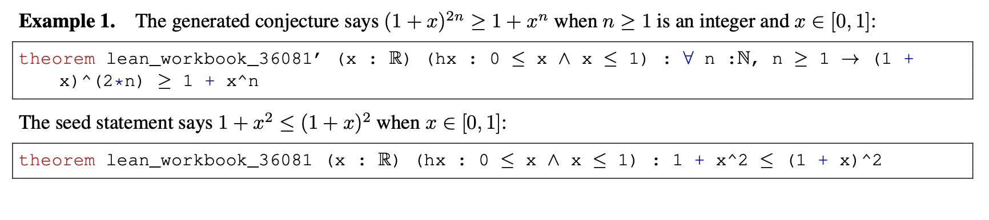
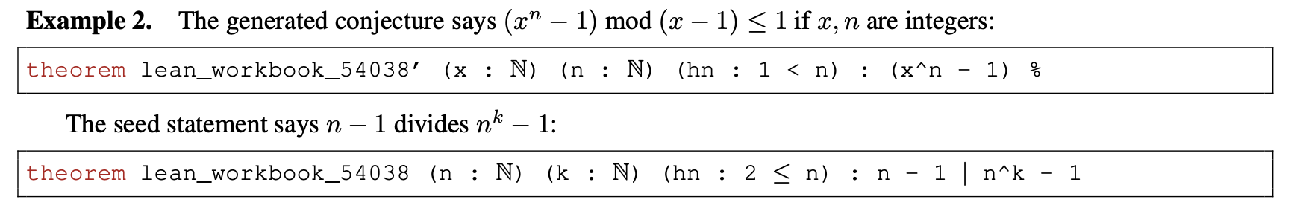
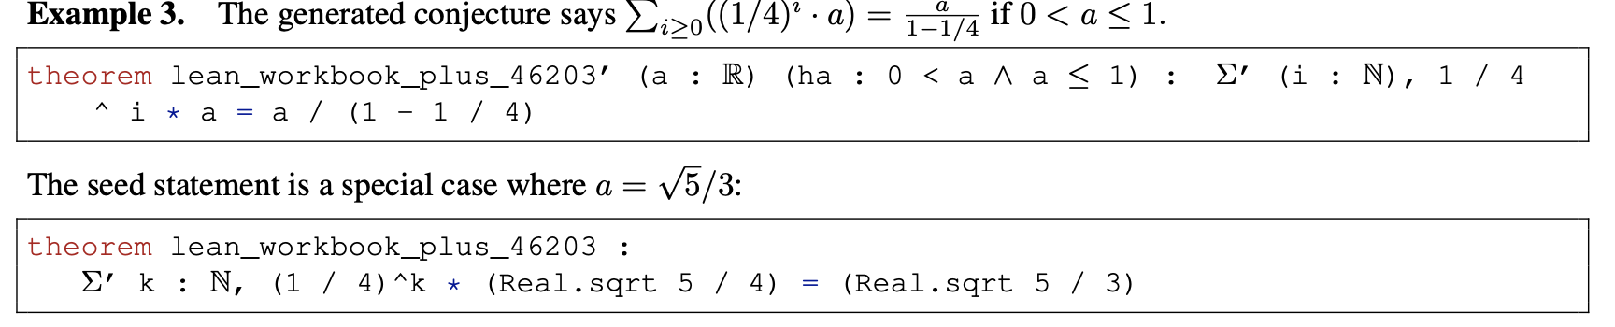
STP: Results
Notes:
Speaker Notes
Premise Selection & Proof Generation:
Discuss how many neural theorem provers (NTPs) need to decide which tactics or lemmas to use at each step—this is very similar to the challenge of premise selection in symbolic systems.
Highlight that tactic-based generation involves searching through a vast space, where methods like MCTS help guide the search but must balance exploration (trying new tactics) with exploitation (following known successful tactics).
Formal Data Scarcity:
Emphasize that one of the biggest hurdles is the scarcity of high-quality formal proof data, which limits supervised training.
Mention that techniques like expert iteration and self-play are used to generate more formalized proofs, but they still can’t fully replace the depth of human-curated datasets.
Integration of Symbolic Methods & Library Learning:
Explain that while neural methods show promise in generating proof steps, integrating them with well-established symbolic tactics (advanced, domain-specific methods) remains challenging.
Point out that a useful prover must effectively tap into formal libraries (like Mathlib) and reconcile neural predictions with symbolic reasoning frameworks.
Scalability & Complexity:
Discuss the inherent complexity due to the combinatorial explosion in the number of possible proof steps and paths.
Note that a practical NTP must manage computational resources efficiently to be viable for real-world formalization tasks.
Generalization & Debugging:
Highlight that generalizing across diverse mathematical domains and proof styles is difficult with current models.
Stress the importance of providing interpretable feedback so users can understand where and why the prover might be failing—this is critical for iterative improvement.

Slide 24
Goedel-Prover: Architecture (Final SFT)
Tackles the data scarcity challenge using a large dataset of autoformalized results with expert-iteration.
No RL, just SFT!
Gets a 7 on PutnamBench and generates 29.7K formal proofs for Lean Workbook
Notes:
Speaker Notes
Premise Selection & Proof Generation:
Discuss how many neural theorem provers (NTPs) need to decide which tactics or lemmas to use at each step—this is very similar to the challenge of premise selection in symbolic systems.
Highlight that tactic-based generation involves searching through a vast space, where methods like MCTS help guide the search but must balance exploration (trying new tactics) with exploitation (following known successful tactics).
Formal Data Scarcity:
Emphasize that one of the biggest hurdles is the scarcity of high-quality formal proof data, which limits supervised training.
Mention that techniques like expert iteration and self-play are used to generate more formalized proofs, but they still can’t fully replace the depth of human-curated datasets.
Integration of Symbolic Methods & Library Learning:
Explain that while neural methods show promise in generating proof steps, integrating them with well-established symbolic tactics (advanced, domain-specific methods) remains challenging.
Point out that a useful prover must effectively tap into formal libraries (like Mathlib) and reconcile neural predictions with symbolic reasoning frameworks.
Scalability & Complexity:
Discuss the inherent complexity due to the combinatorial explosion in the number of possible proof steps and paths.
Note that a practical NTP must manage computational resources efficiently to be viable for real-world formalization tasks.
Generalization & Debugging:
Highlight that generalizing across diverse mathematical domains and proof styles is difficult with current models.
Stress the importance of providing interpretable feedback so users can understand where and why the prover might be failing—this is critical for iterative improvement.

Slide 25
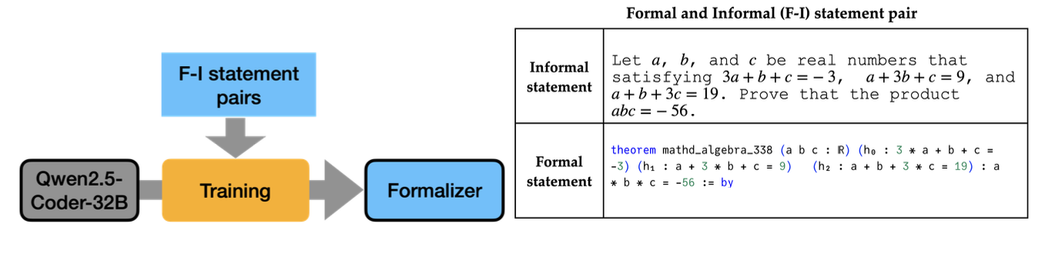
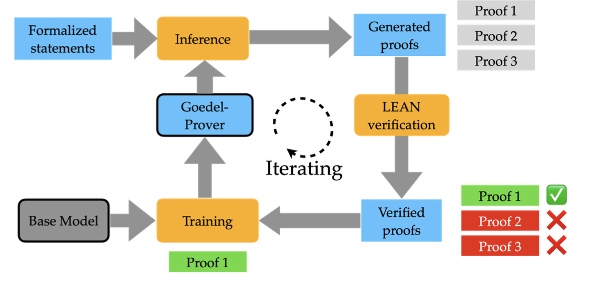
Goedel-Prover: Architecture
Notes:
Speaker Notes
Premise Selection & Proof Generation:
Discuss how many neural theorem provers (NTPs) need to decide which tactics or lemmas to use at each step—this is very similar to the challenge of premise selection in symbolic systems.
Highlight that tactic-based generation involves searching through a vast space, where methods like MCTS help guide the search but must balance exploration (trying new tactics) with exploitation (following known successful tactics).
Formal Data Scarcity:
Emphasize that one of the biggest hurdles is the scarcity of high-quality formal proof data, which limits supervised training.
Mention that techniques like expert iteration and self-play are used to generate more formalized proofs, but they still can’t fully replace the depth of human-curated datasets.
Integration of Symbolic Methods & Library Learning:
Explain that while neural methods show promise in generating proof steps, integrating them with well-established symbolic tactics (advanced, domain-specific methods) remains challenging.
Point out that a useful prover must effectively tap into formal libraries (like Mathlib) and reconcile neural predictions with symbolic reasoning frameworks.
Scalability & Complexity:
Discuss the inherent complexity due to the combinatorial explosion in the number of possible proof steps and paths.
Note that a practical NTP must manage computational resources efficiently to be viable for real-world formalization tasks.
Generalization & Debugging:
Highlight that generalizing across diverse mathematical domains and proof styles is difficult with current models.
Stress the importance of providing interpretable feedback so users can understand where and why the prover might be failing—this is critical for iterative improvement.

Slide 26
Goedel-Prover: Architecture (Formalization)
Trains two (statement) formalizers to translate informal statements in Numina into formal statements as shown in Figure 2.
Formalizer A: trained (SFT Qwen2.5-Coder-32B) on formal/informal pairs sourced from Lean Workbook.
Formalizer B: trained (same) on 170K formal/informal pairs of statements in Numina that were successfully formalized by Claude-Sonnet-3.5.
Notes:
Speaker Notes
Premise Selection & Proof Generation:
Discuss how many neural theorem provers (NTPs) need to decide which tactics or lemmas to use at each step—this is very similar to the challenge of premise selection in symbolic systems.
Highlight that tactic-based generation involves searching through a vast space, where methods like MCTS help guide the search but must balance exploration (trying new tactics) with exploitation (following known successful tactics).
Formal Data Scarcity:
Emphasize that one of the biggest hurdles is the scarcity of high-quality formal proof data, which limits supervised training.
Mention that techniques like expert iteration and self-play are used to generate more formalized proofs, but they still can’t fully replace the depth of human-curated datasets.
Integration of Symbolic Methods & Library Learning:
Explain that while neural methods show promise in generating proof steps, integrating them with well-established symbolic tactics (advanced, domain-specific methods) remains challenging.
Point out that a useful prover must effectively tap into formal libraries (like Mathlib) and reconcile neural predictions with symbolic reasoning frameworks.
Scalability & Complexity:
Discuss the inherent complexity due to the combinatorial explosion in the number of possible proof steps and paths.
Note that a practical NTP must manage computational resources efficiently to be viable for real-world formalization tasks.
Generalization & Debugging:
Highlight that generalizing across diverse mathematical domains and proof styles is difficult with current models.
Stress the importance of providing interpretable feedback so users can understand where and why the prover might be failing—this is critical for iterative improvement.

Slide 27
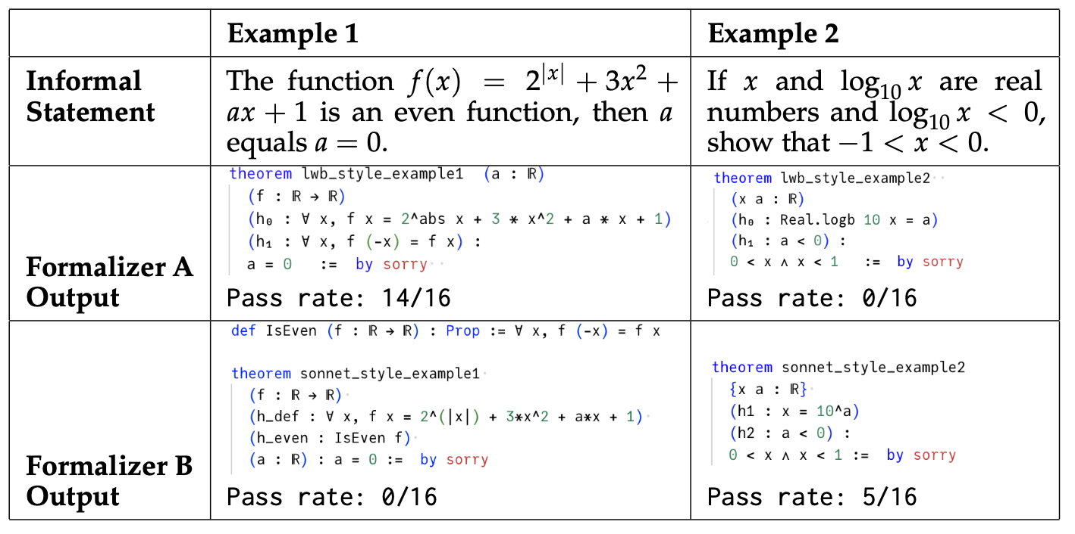
Goedel-Prover: Architecture (Formalization)
Notes:
Speaker Notes
Premise Selection & Proof Generation:
Discuss how many neural theorem provers (NTPs) need to decide which tactics or lemmas to use at each step—this is very similar to the challenge of premise selection in symbolic systems.
Highlight that tactic-based generation involves searching through a vast space, where methods like MCTS help guide the search but must balance exploration (trying new tactics) with exploitation (following known successful tactics).
Formal Data Scarcity:
Emphasize that one of the biggest hurdles is the scarcity of high-quality formal proof data, which limits supervised training.
Mention that techniques like expert iteration and self-play are used to generate more formalized proofs, but they still can’t fully replace the depth of human-curated datasets.
Integration of Symbolic Methods & Library Learning:
Explain that while neural methods show promise in generating proof steps, integrating them with well-established symbolic tactics (advanced, domain-specific methods) remains challenging.
Point out that a useful prover must effectively tap into formal libraries (like Mathlib) and reconcile neural predictions with symbolic reasoning frameworks.
Scalability & Complexity:
Discuss the inherent complexity due to the combinatorial explosion in the number of possible proof steps and paths.
Note that a practical NTP must manage computational resources efficiently to be viable for real-world formalization tasks.
Generalization & Debugging:
Highlight that generalizing across diverse mathematical domains and proof styles is difficult with current models.
Stress the importance of providing interpretable feedback so users can understand where and why the prover might be failing—this is critical for iterative improvement.

Slide 28
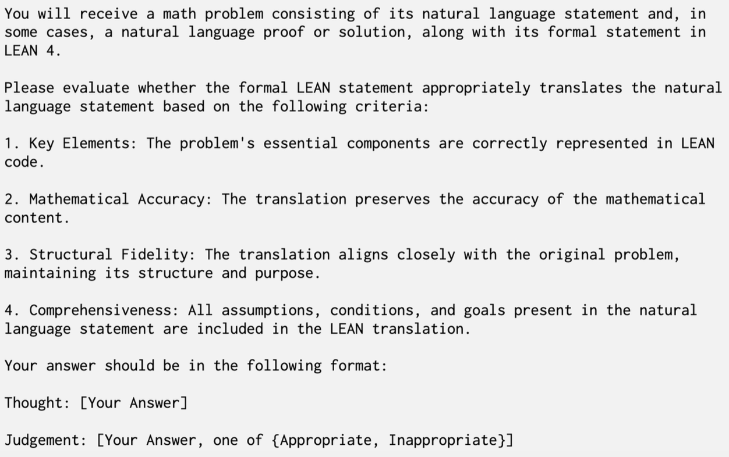
Goedel-Prover: Architecture (Formalization)
Judge quality of formalization by:
CC: Compiles in Lean
FC: Qwen2.5-72B-Instruct determines if the formalization is “appropriate”. Calculate #{“Appropriate” in four Judgments}/4
Construct dataset by filtering out false CC and FC<0.5
Notes:
Speaker Notes
Premise Selection & Proof Generation:
Discuss how many neural theorem provers (NTPs) need to decide which tactics or lemmas to use at each step—this is very similar to the challenge of premise selection in symbolic systems.
Highlight that tactic-based generation involves searching through a vast space, where methods like MCTS help guide the search but must balance exploration (trying new tactics) with exploitation (following known successful tactics).
Formal Data Scarcity:
Emphasize that one of the biggest hurdles is the scarcity of high-quality formal proof data, which limits supervised training.
Mention that techniques like expert iteration and self-play are used to generate more formalized proofs, but they still can’t fully replace the depth of human-curated datasets.
Integration of Symbolic Methods & Library Learning:
Explain that while neural methods show promise in generating proof steps, integrating them with well-established symbolic tactics (advanced, domain-specific methods) remains challenging.
Point out that a useful prover must effectively tap into formal libraries (like Mathlib) and reconcile neural predictions with symbolic reasoning frameworks.
Scalability & Complexity:
Discuss the inherent complexity due to the combinatorial explosion in the number of possible proof steps and paths.
Note that a practical NTP must manage computational resources efficiently to be viable for real-world formalization tasks.
Generalization & Debugging:
Highlight that generalizing across diverse mathematical domains and proof styles is difficult with current models.
Stress the importance of providing interpretable feedback so users can understand where and why the prover might be failing—this is critical for iterative improvement.

Slide 29
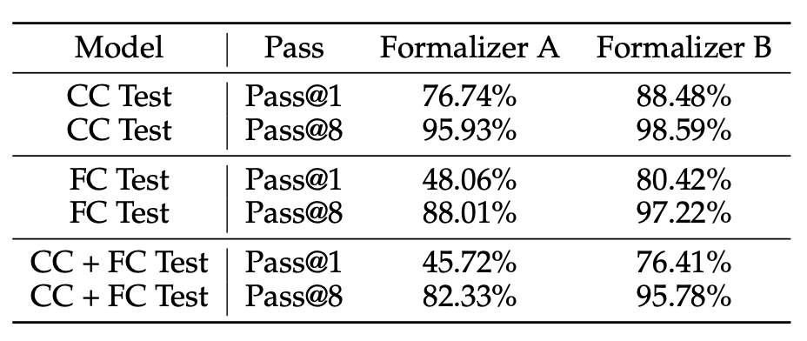
Goedel-Prover: Architecture (Formalization)
Dataset
For each informal statement in Numina, we generate eight formalized statements from each formalizer (16 total)
Filter by CC,FC tests and randomly select a valid statement from each formalizer.
860K open-sourced Numina problems, (private) 68K problems from AOPS.
Of 928K statements, 760K have two valid formalized statements, and 123K contain only one valid formalized statement.
Then add 140K statements from Lean Workbook (Plus), for a total of 1.78M statements
Notes:
Speaker Notes
Premise Selection & Proof Generation:
Discuss how many neural theorem provers (NTPs) need to decide which tactics or lemmas to use at each step—this is very similar to the challenge of premise selection in symbolic systems.
Highlight that tactic-based generation involves searching through a vast space, where methods like MCTS help guide the search but must balance exploration (trying new tactics) with exploitation (following known successful tactics).
Formal Data Scarcity:
Emphasize that one of the biggest hurdles is the scarcity of high-quality formal proof data, which limits supervised training.
Mention that techniques like expert iteration and self-play are used to generate more formalized proofs, but they still can’t fully replace the depth of human-curated datasets.
Integration of Symbolic Methods & Library Learning:
Explain that while neural methods show promise in generating proof steps, integrating them with well-established symbolic tactics (advanced, domain-specific methods) remains challenging.
Point out that a useful prover must effectively tap into formal libraries (like Mathlib) and reconcile neural predictions with symbolic reasoning frameworks.
Scalability & Complexity:
Discuss the inherent complexity due to the combinatorial explosion in the number of possible proof steps and paths.
Note that a practical NTP must manage computational resources efficiently to be viable for real-world formalization tasks.
Generalization & Debugging:
Highlight that generalizing across diverse mathematical domains and proof styles is difficult with current models.
Stress the importance of providing interpretable feedback so users can understand where and why the prover might be failing—this is critical for iterative improvement.

Slide 30
Goedel-Prover: Architecture (Expert Iteration)
Uses DeepSeek-Prover-V1.5-RL to generate 16 proofs for each statement. Then verify these proofs with the Lean compiler. If at least one proof solves the statement, we retain one proof per statement. In cases where multiple proofs are available, randomly sample one solution.
These collected proofs are used for supervised fine-tuning (SFT) based on DeepSeek-Prover-V1.5-Base, resulting in the iter-1 prover.
Repeat!
Notes:
Speaker Notes
Premise Selection & Proof Generation:
Discuss how many neural theorem provers (NTPs) need to decide which tactics or lemmas to use at each step—this is very similar to the challenge of premise selection in symbolic systems.
Highlight that tactic-based generation involves searching through a vast space, where methods like MCTS help guide the search but must balance exploration (trying new tactics) with exploitation (following known successful tactics).
Formal Data Scarcity:
Emphasize that one of the biggest hurdles is the scarcity of high-quality formal proof data, which limits supervised training.
Mention that techniques like expert iteration and self-play are used to generate more formalized proofs, but they still can’t fully replace the depth of human-curated datasets.
Integration of Symbolic Methods & Library Learning:
Explain that while neural methods show promise in generating proof steps, integrating them with well-established symbolic tactics (advanced, domain-specific methods) remains challenging.
Point out that a useful prover must effectively tap into formal libraries (like Mathlib) and reconcile neural predictions with symbolic reasoning frameworks.
Scalability & Complexity:
Discuss the inherent complexity due to the combinatorial explosion in the number of possible proof steps and paths.
Note that a practical NTP must manage computational resources efficiently to be viable for real-world formalization tasks.
Generalization & Debugging:
Highlight that generalizing across diverse mathematical domains and proof styles is difficult with current models.
Stress the importance of providing interpretable feedback so users can understand where and why the prover might be failing—this is critical for iterative improvement.

Slide 31
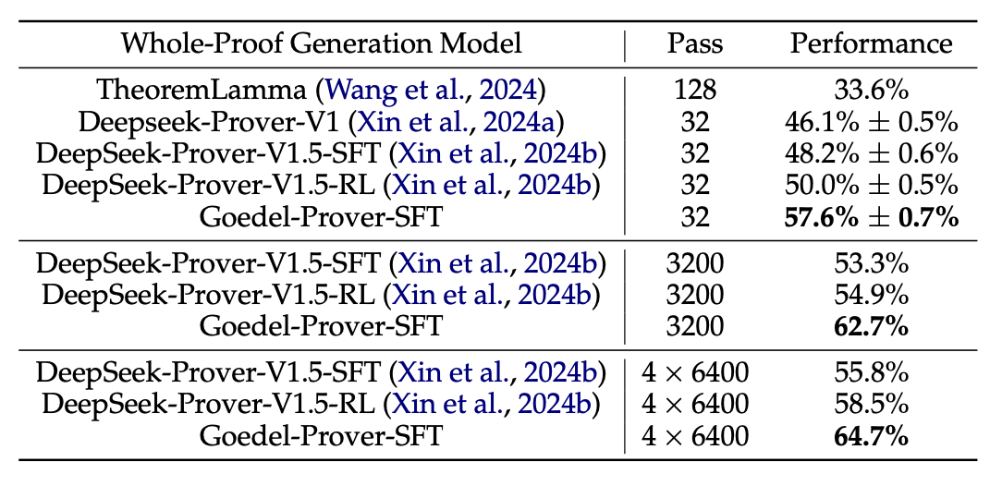
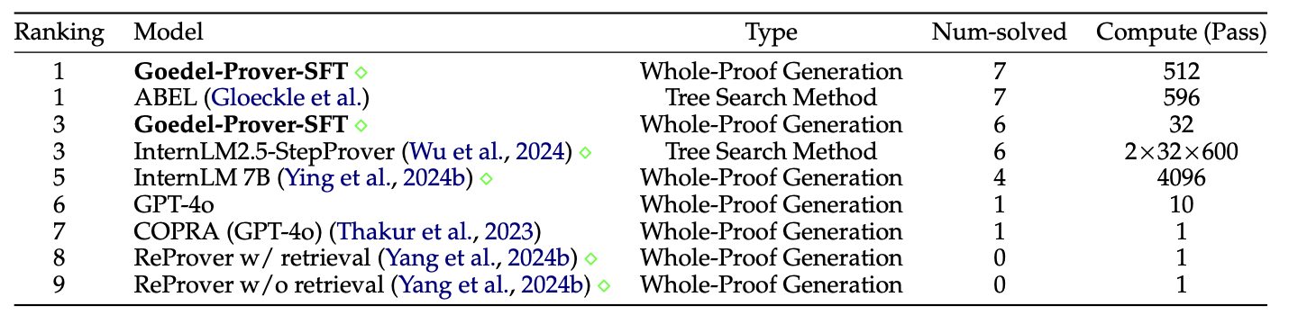
Goedel-Prover: Results
Notes:
Speaker Notes
Premise Selection & Proof Generation:
Discuss how many neural theorem provers (NTPs) need to decide which tactics or lemmas to use at each step—this is very similar to the challenge of premise selection in symbolic systems.
Highlight that tactic-based generation involves searching through a vast space, where methods like MCTS help guide the search but must balance exploration (trying new tactics) with exploitation (following known successful tactics).
Formal Data Scarcity:
Emphasize that one of the biggest hurdles is the scarcity of high-quality formal proof data, which limits supervised training.
Mention that techniques like expert iteration and self-play are used to generate more formalized proofs, but they still can’t fully replace the depth of human-curated datasets.
Integration of Symbolic Methods & Library Learning:
Explain that while neural methods show promise in generating proof steps, integrating them with well-established symbolic tactics (advanced, domain-specific methods) remains challenging.
Point out that a useful prover must effectively tap into formal libraries (like Mathlib) and reconcile neural predictions with symbolic reasoning frameworks.
Scalability & Complexity:
Discuss the inherent complexity due to the combinatorial explosion in the number of possible proof steps and paths.
Note that a practical NTP must manage computational resources efficiently to be viable for real-world formalization tasks.
Generalization & Debugging:
Highlight that generalizing across diverse mathematical domains and proof styles is difficult with current models.
Stress the importance of providing interpretable feedback so users can understand where and why the prover might be failing—this is critical for iterative improvement.

Slide 32
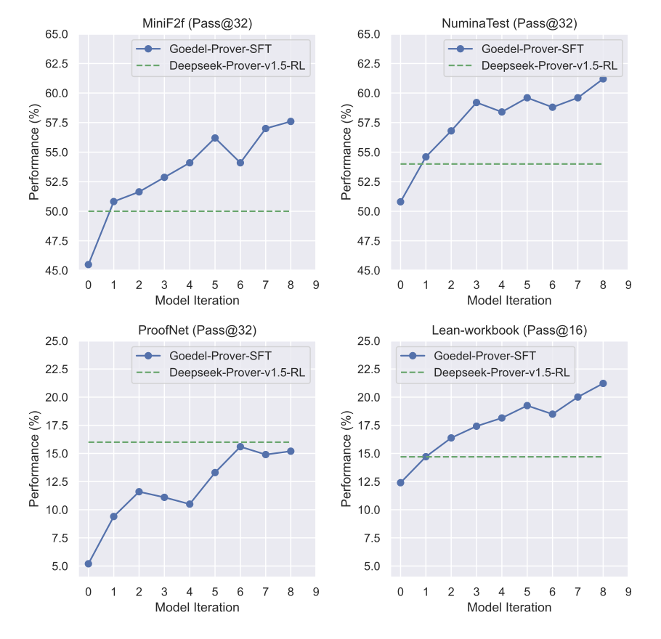
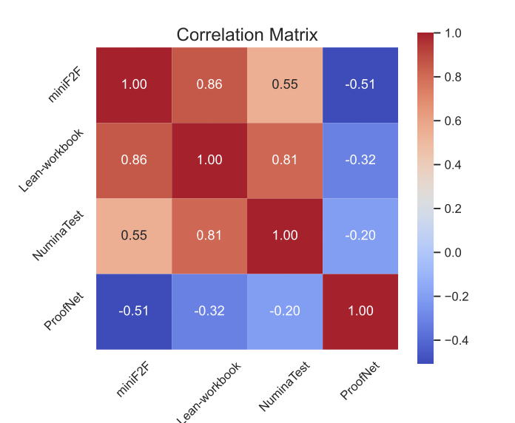
Goedel-Prover: Results
Notes:
Speaker Notes
Premise Selection & Proof Generation:
Discuss how many neural theorem provers (NTPs) need to decide which tactics or lemmas to use at each step—this is very similar to the challenge of premise selection in symbolic systems.
Highlight that tactic-based generation involves searching through a vast space, where methods like MCTS help guide the search but must balance exploration (trying new tactics) with exploitation (following known successful tactics).
Formal Data Scarcity:
Emphasize that one of the biggest hurdles is the scarcity of high-quality formal proof data, which limits supervised training.
Mention that techniques like expert iteration and self-play are used to generate more formalized proofs, but they still can’t fully replace the depth of human-curated datasets.
Integration of Symbolic Methods & Library Learning:
Explain that while neural methods show promise in generating proof steps, integrating them with well-established symbolic tactics (advanced, domain-specific methods) remains challenging.
Point out that a useful prover must effectively tap into formal libraries (like Mathlib) and reconcile neural predictions with symbolic reasoning frameworks.
Scalability & Complexity:
Discuss the inherent complexity due to the combinatorial explosion in the number of possible proof steps and paths.
Note that a practical NTP must manage computational resources efficiently to be viable for real-world formalization tasks.
Generalization & Debugging:
Highlight that generalizing across diverse mathematical domains and proof styles is difficult with current models.
Stress the importance of providing interpretable feedback so users can understand where and why the prover might be failing—this is critical for iterative improvement.

Slide 33
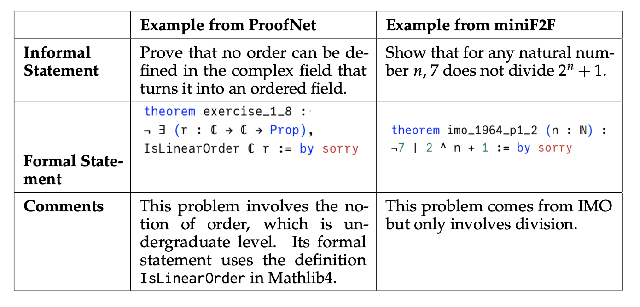
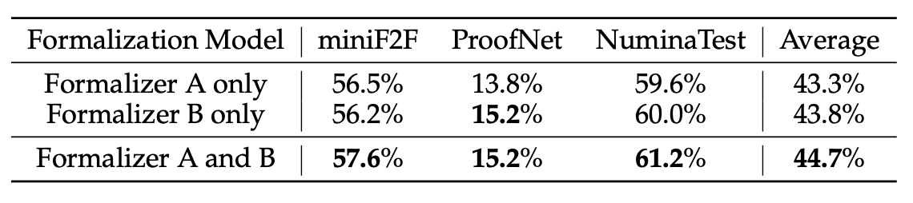
Goedel-Prover: Results
Notes:
Speaker Notes
Premise Selection & Proof Generation:
Discuss how many neural theorem provers (NTPs) need to decide which tactics or lemmas to use at each step—this is very similar to the challenge of premise selection in symbolic systems.
Highlight that tactic-based generation involves searching through a vast space, where methods like MCTS help guide the search but must balance exploration (trying new tactics) with exploitation (following known successful tactics).
Formal Data Scarcity:
Emphasize that one of the biggest hurdles is the scarcity of high-quality formal proof data, which limits supervised training.
Mention that techniques like expert iteration and self-play are used to generate more formalized proofs, but they still can’t fully replace the depth of human-curated datasets.
Integration of Symbolic Methods & Library Learning:
Explain that while neural methods show promise in generating proof steps, integrating them with well-established symbolic tactics (advanced, domain-specific methods) remains challenging.
Point out that a useful prover must effectively tap into formal libraries (like Mathlib) and reconcile neural predictions with symbolic reasoning frameworks.
Scalability & Complexity:
Discuss the inherent complexity due to the combinatorial explosion in the number of possible proof steps and paths.
Note that a practical NTP must manage computational resources efficiently to be viable for real-world formalization tasks.
Generalization & Debugging:
Highlight that generalizing across diverse mathematical domains and proof styles is difficult with current models.
Stress the importance of providing interpretable feedback so users can understand where and why the prover might be failing—this is critical for iterative improvement.

Slide 34
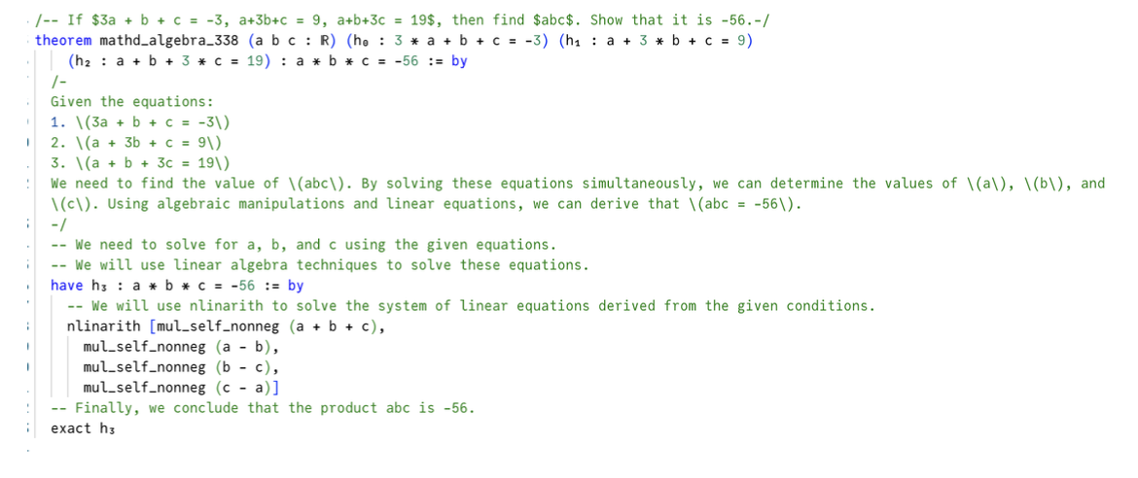
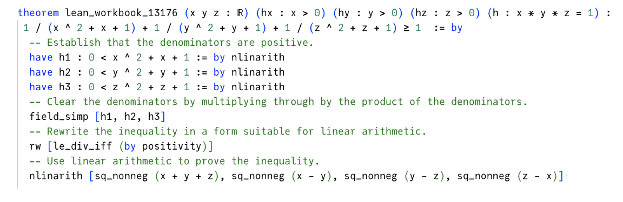
Goedel-Prover: Architecture (Results)
Notes:
Speaker Notes
Premise Selection & Proof Generation:
Discuss how many neural theorem provers (NTPs) need to decide which tactics or lemmas to use at each step—this is very similar to the challenge of premise selection in symbolic systems.
Highlight that tactic-based generation involves searching through a vast space, where methods like MCTS help guide the search but must balance exploration (trying new tactics) with exploitation (following known successful tactics).
Formal Data Scarcity:
Emphasize that one of the biggest hurdles is the scarcity of high-quality formal proof data, which limits supervised training.
Mention that techniques like expert iteration and self-play are used to generate more formalized proofs, but they still can’t fully replace the depth of human-curated datasets.
Integration of Symbolic Methods & Library Learning:
Explain that while neural methods show promise in generating proof steps, integrating them with well-established symbolic tactics (advanced, domain-specific methods) remains challenging.
Point out that a useful prover must effectively tap into formal libraries (like Mathlib) and reconcile neural predictions with symbolic reasoning frameworks.
Scalability & Complexity:
Discuss the inherent complexity due to the combinatorial explosion in the number of possible proof steps and paths.
Note that a practical NTP must manage computational resources efficiently to be viable for real-world formalization tasks.
Generalization & Debugging:
Highlight that generalizing across diverse mathematical domains and proof styles is difficult with current models.
Stress the importance of providing interpretable feedback so users can understand where and why the prover might be failing—this is critical for iterative improvement.

Slide 35
Goedel-Prover: Results
Notes:
Speaker Notes
Premise Selection & Proof Generation:
Discuss how many neural theorem provers (NTPs) need to decide which tactics or lemmas to use at each step—this is very similar to the challenge of premise selection in symbolic systems.
Highlight that tactic-based generation involves searching through a vast space, where methods like MCTS help guide the search but must balance exploration (trying new tactics) with exploitation (following known successful tactics).
Formal Data Scarcity:
Emphasize that one of the biggest hurdles is the scarcity of high-quality formal proof data, which limits supervised training.
Mention that techniques like expert iteration and self-play are used to generate more formalized proofs, but they still can’t fully replace the depth of human-curated datasets.
Integration of Symbolic Methods & Library Learning:
Explain that while neural methods show promise in generating proof steps, integrating them with well-established symbolic tactics (advanced, domain-specific methods) remains challenging.
Point out that a useful prover must effectively tap into formal libraries (like Mathlib) and reconcile neural predictions with symbolic reasoning frameworks.
Scalability & Complexity:
Discuss the inherent complexity due to the combinatorial explosion in the number of possible proof steps and paths.
Note that a practical NTP must manage computational resources efficiently to be viable for real-world formalization tasks.
Generalization & Debugging:
Highlight that generalizing across diverse mathematical domains and proof styles is difficult with current models.
Stress the importance of providing interpretable feedback so users can understand where and why the prover might be failing—this is critical for iterative improvement.

Slide 36
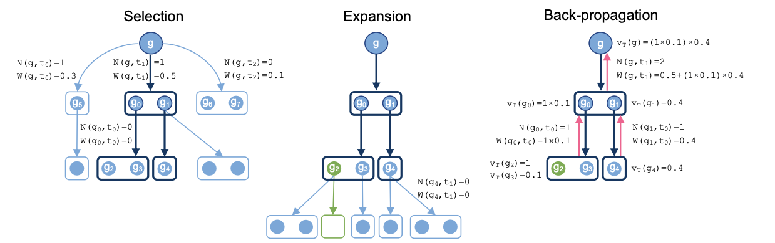
Other Works
These are powerful methods to address the data problem, but there are many others that address other challenges as well:
Proof Generation
Deepseek-Prover-1.5: MCTS
HTPS
DT-Prover, LeanProgress: MCTS guided by expected number of tactics to solve goal
Library Learning
Minimo (kinda)
MaLARea: Conjecturer/Prover with library building
Premise Selection
HOLLight, HOL(y) Hammer
Machine-Learned Premise Selection: Trains embeddings for Lean premises
Online RL
ABEL, Alphaproof: test-time variant generation online RL
Notes:
Speaker Notes
Premise Selection & Proof Generation:
Discuss how many neural theorem provers (NTPs) need to decide which tactics or lemmas to use at each step—this is very similar to the challenge of premise selection in symbolic systems.
Highlight that tactic-based generation involves searching through a vast space, where methods like MCTS help guide the search but must balance exploration (trying new tactics) with exploitation (following known successful tactics).
Formal Data Scarcity:
Emphasize that one of the biggest hurdles is the scarcity of high-quality formal proof data, which limits supervised training.
Mention that techniques like expert iteration and self-play are used to generate more formalized proofs, but they still can’t fully replace the depth of human-curated datasets.
Integration of Symbolic Methods & Library Learning:
Explain that while neural methods show promise in generating proof steps, integrating them with well-established symbolic tactics (advanced, domain-specific methods) remains challenging.
Point out that a useful prover must effectively tap into formal libraries (like Mathlib) and reconcile neural predictions with symbolic reasoning frameworks.
Scalability & Complexity:
Discuss the inherent complexity due to the combinatorial explosion in the number of possible proof steps and paths.
Note that a practical NTP must manage computational resources efficiently to be viable for real-world formalization tasks.
Generalization & Debugging:
Highlight that generalizing across diverse mathematical domains and proof styles is difficult with current models.
Stress the importance of providing interpretable feedback so users can understand where and why the prover might be failing—this is critical for iterative improvement.

Slide 37
Towards A Proposal (General Discussion)
Some thoughts:
Goedel-Prover uses scale as its main advantage, as facilitated by the giant (informal) Numina corpus
STP uses RL and the conjecturer-prover system to not need as large of an initial corpus, but ends up self-generating around the same amount
STP’s conjecturing system is quite naive (lemma-similarity)
Conjectured lemmas are really only for data augmentation – not for genuine generalization, usefulness, etc.
Conjectured theorems are not stored for library learning/premise selection
STP and Goedel both employ full-proof generation, could get better performance from tree search
Neither STP, Goedel track context of theorems (so less extensible to full-scale projects for users to use)
Neither STP, Goedel usable at a user-facing level
Should be possible to grant STP access to more tactics and extend the self-play process into test-time for Online RL.
Notes:
Speaker Notes
Premise Selection & Proof Generation:
Discuss how many neural theorem provers (NTPs) need to decide which tactics or lemmas to use at each step—this is very similar to the challenge of premise selection in symbolic systems.
Highlight that tactic-based generation involves searching through a vast space, where methods like MCTS help guide the search but must balance exploration (trying new tactics) with exploitation (following known successful tactics).
Formal Data Scarcity:
Emphasize that one of the biggest hurdles is the scarcity of high-quality formal proof data, which limits supervised training.
Mention that techniques like expert iteration and self-play are used to generate more formalized proofs, but they still can’t fully replace the depth of human-curated datasets.
Integration of Symbolic Methods & Library Learning:
Explain that while neural methods show promise in generating proof steps, integrating them with well-established symbolic tactics (advanced, domain-specific methods) remains challenging.
Point out that a useful prover must effectively tap into formal libraries (like Mathlib) and reconcile neural predictions with symbolic reasoning frameworks.
Scalability & Complexity:
Discuss the inherent complexity due to the combinatorial explosion in the number of possible proof steps and paths.
Note that a practical NTP must manage computational resources efficiently to be viable for real-world formalization tasks.
Generalization & Debugging:
Highlight that generalizing across diverse mathematical domains and proof styles is difficult with current models.
Stress the importance of providing interpretable feedback so users can understand where and why the prover might be failing—this is critical for iterative improvement.

